Slide 1
Energy Savings Workshop Fox Valley Sustainability Energy Efficiency Workshop November 21, 2019
Vetia Hill, Community Organizer

Slide 2
Elevate Energy
Non-profit established in 2000
Design & implement energy efficiency programs to:
Cut costs
Protect the environment
Ensure that the benefits of energy efficiency reach ALL people

Slide 3
Workshop Agenda
Elevate Energy
Smart Grid and Smart Meters
Our Energy Options in Illinois
New Pricing Options
Utility Energy Efficiency Incentives
Questions and Answers

Slide 4
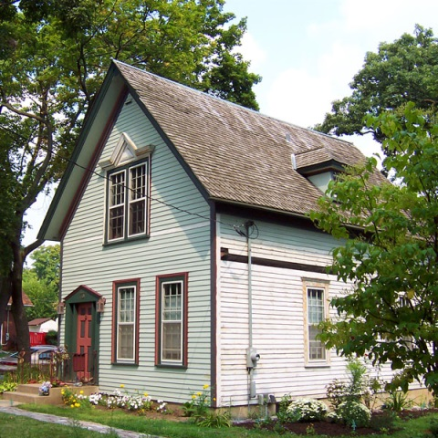
Smart Grid and Smart Meters
What is the Smart Grid?
Update to our aging power grid through ComEd and Ameren Illinois.
Work to be completed by 2018.
Fewer power outages and less waiting for service restoration.
Fewer wasted costs.
What is a Smart Meter?
Digital meter.
No more estimated bills.
Real-time information on power use.
New options for electricity rates.
Notes:
Eli

Slide 5
Home Energy Loss
Where do our homes lose the most energy?
Notes:
Eli

Slide 6
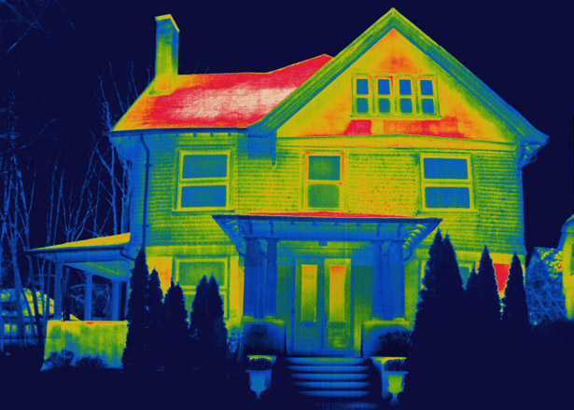
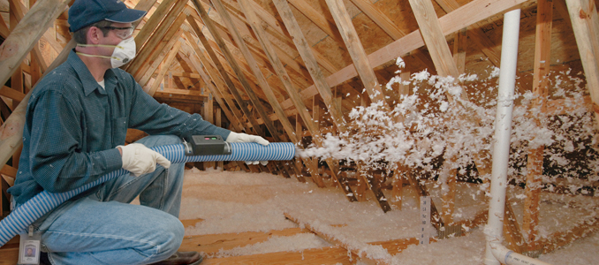
Energy Loss at Home
An average of 48% of our energy costs come from heating and cooling.
Energy Loss at Home:
68% through Attic and Basement
22% Walls
10% Windows
Most cost-effective solutions?
Notes:
Eli

Slide 7
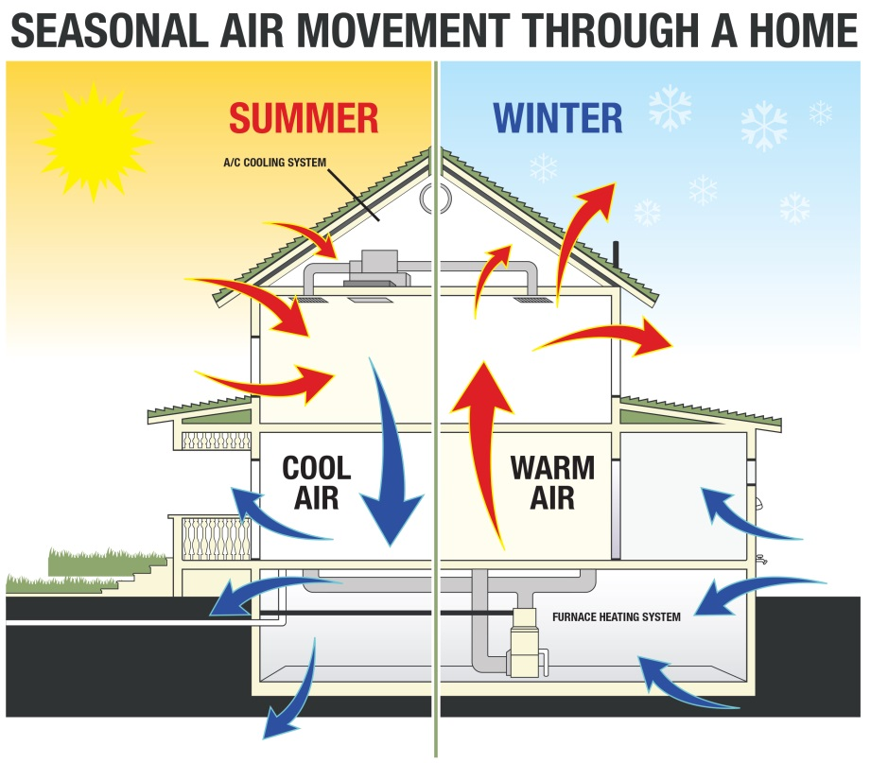
Making Your Home More Efficient
Notes:
Eli

Slide 8
Our Electricity Options in Illinois
www.PlugInIllinois.org
Notes:
Annabelle

Slide 9
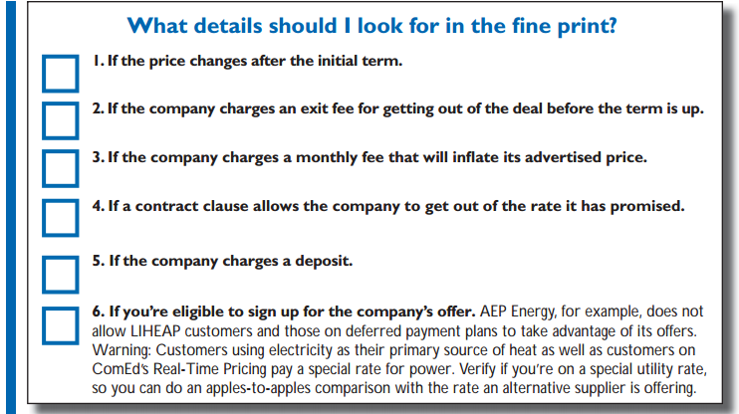
Alternative Electric Supplier Checklist
www.CitizensUtilityBoard.org
Notes:
Annabelle

Slide 10
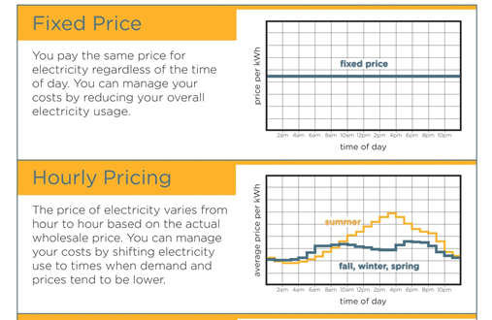
Using Your Smart Meter to Lower Costs
ComEd:
7.22 cents per kWh
(October 2019)
Changes hour-by-hour:
Cheaper mornings, nights, weekends.
Notes:
Eli

Slide 11
Elevate Energy administers the NPO offerings in part with COMEDs energy efficiency portfolio
Elevate Energy is here to help Non-Profit organizations reduce energy consumption and redirect those savings back into the community

Slide 12
Our Non-Profit & Public Facility Programs
Lighting, HVAC systems
Assessments (1 month) simple pay back- costs on your electric bill
Current project in mind, like lighting, (contract on site 2 weeks)- they can reach out to a contractor
Higher electric incentives to direct services to people that are more at risk
Watts reduced incentive (1.20$)- lighting
Direct install lighting (screw in light bulbs)
Incentives for roof top unit and some HVAC

Slide 13
Contacts or Questions for Non-Profit?
nonprofitteam@elevateenergy.org
Most successful opportunities for facilities in communities that “need it the most’
Start with an assessment

Slide 14
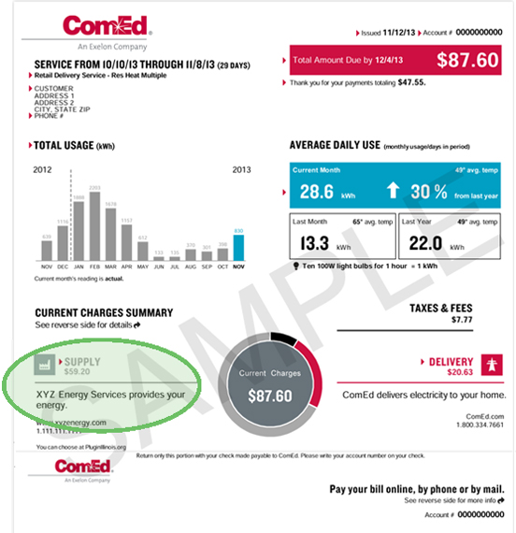
Notes:
Annabelle

Slide 15
Dynamic Pricing
What time of day do we all want to use electricity at once?
“Peaks and valleys” in electrical use are detrimental
Expensive for consumers
Harmful to the environment
Dynamic Pricing Programs
Required by law because they benefit consumers
Incentivize shifting electrical usage to non-peak times
Notes:
Eli

Slide 16
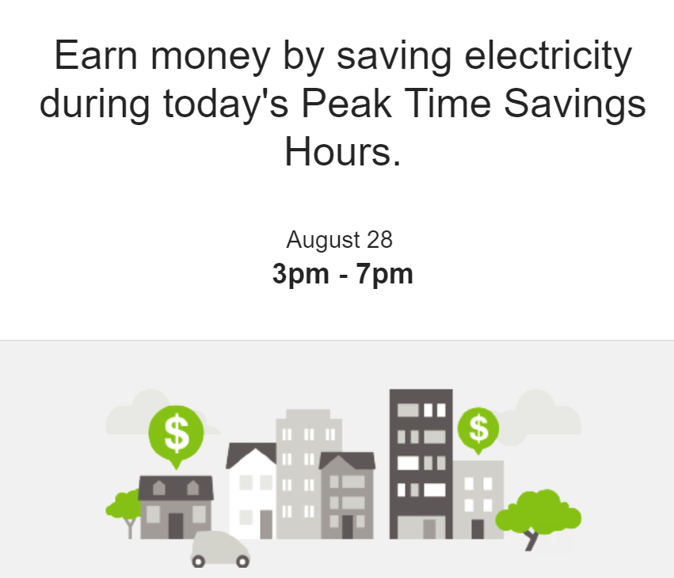
Peak-Time Savings
ComEd will alert you in advance of a “high usage period”
Reduce your usage during those hours and earn a $1 credit for every kWh you save
Notes:
Annabelle

Slide 17
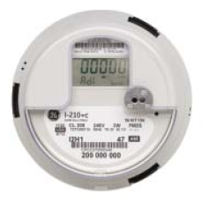
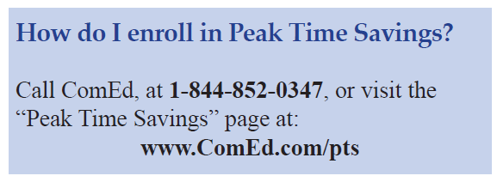
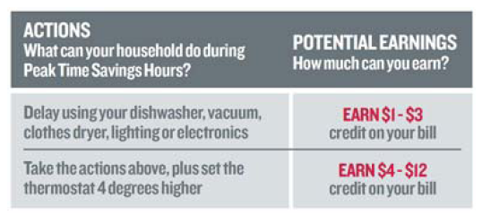
Peak-Time Savings
Peak Time Savings:
Scheduled periods on 3 to 5 hot summer days when ComEd will give participants the option of delaying heavy power usage to earn bill credits.
Notes:
Annabelle

Slide 18
Solar Energy Jobs Training/Application
https://www.elevateenergy.org/solar-training-app/
Recruitment starts next week!
October 22nd at Safer Organization (808 S Kedzie Ave, Chicago, IL 60612) @10am
November 21st at Safer Organization (808 S Kedzie Ave, Chicago, IL 60612) @ @10am
November 14 at Wright College- Humboldt Park (1645 N California Ave, Chicago, IL 60647) @10am
December 12th at Safer Organization (808 S Kedzie Ave, Chicago, IL 60612) @ @10am

