Slide 1
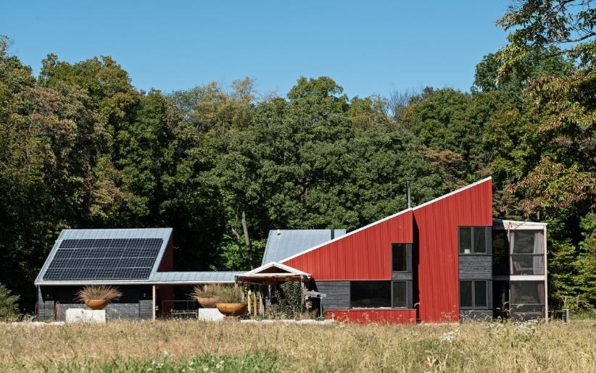
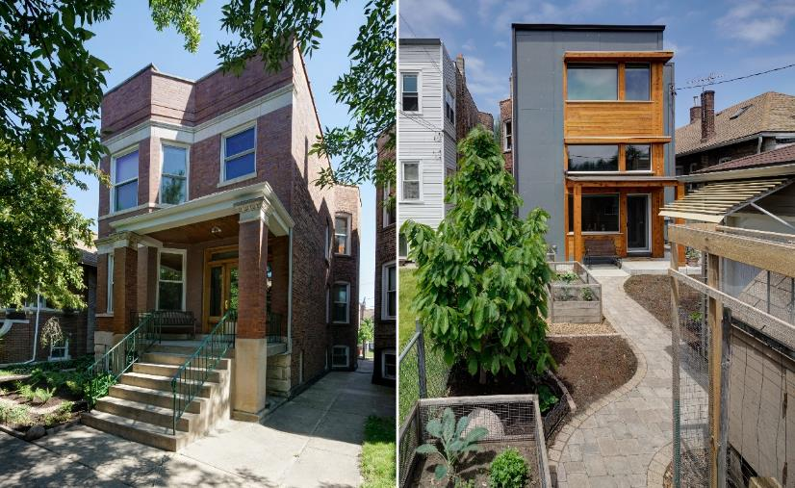
Net Zero Energy: Design
Tom Bassett-Dilley AIA, CPHC
President, Tom Bassett-Dilley Architects, Ltd. (TBDA)
Passive House Alliance Chicago (Board Member) and Passive House Alliance National Council (regional rep)

Slide 2
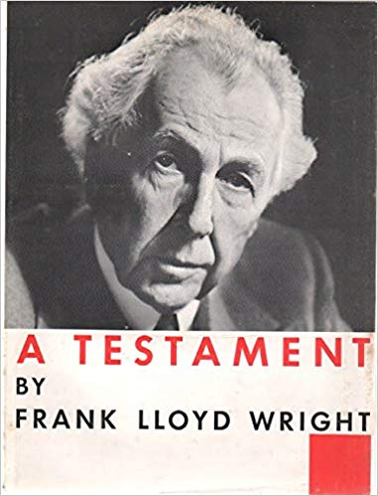
My start..
+

Slide 3
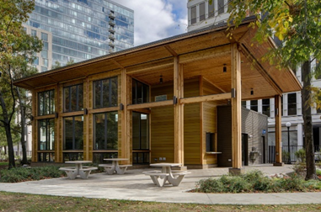
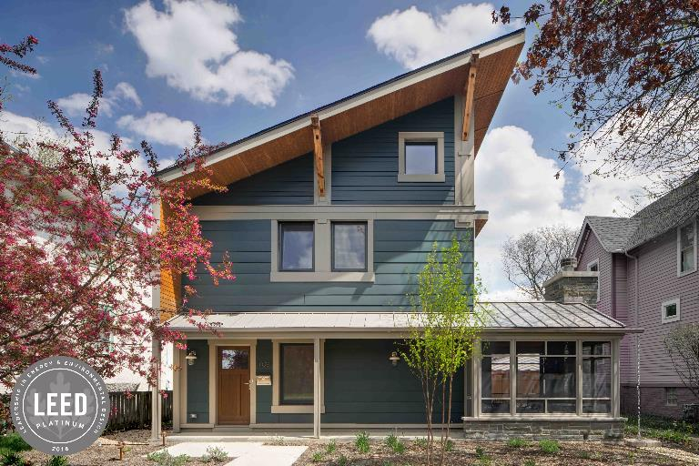
TBDA, Ltd. Est. 2006 to pursue sustainable design
Our mission:
Healthy – Beautiful – Efficient Buildings for a clean-energy future
Certified Passive House Consultants
Passive House, LEED, GreenStar, DOE ZERH certified buildings
Frame - ICFs – SIPs – Modular Prefab

Slide 4
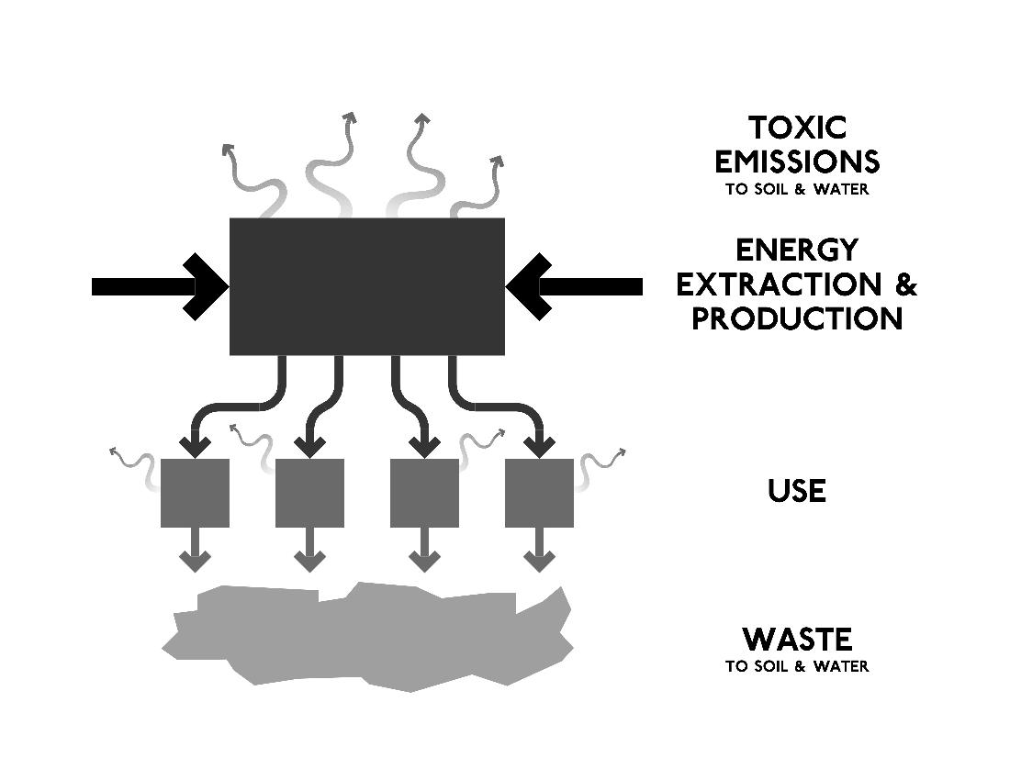
Machine?
Our model for the last few centuries.

Slide 5
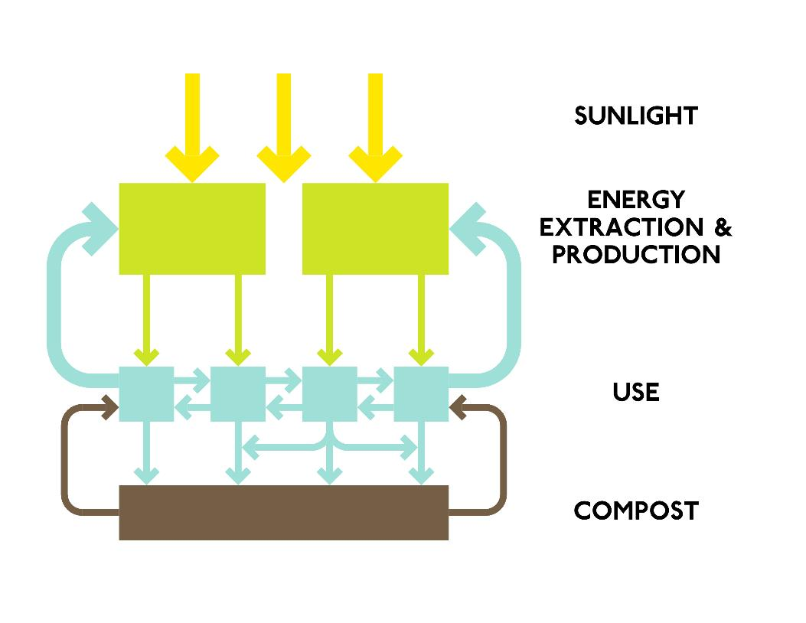
Nature
Our model for the future.
Biomimicry: using study of natural systems and organisms to evolve design solutions
See RMI’s “Reinventing Fire” for a view toward beneficial electrification, distributed grid, etc.

Slide 6
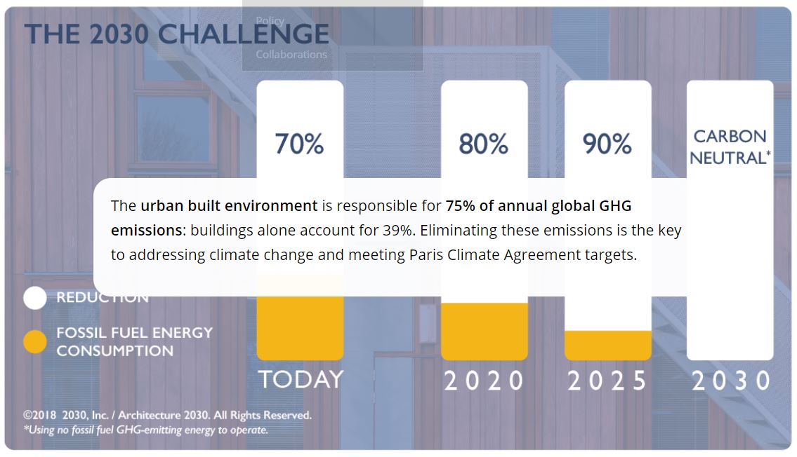
Architecture 2030
Our commitment: a path to zero carbon by 2030. Buildings become part of the solution to climate change, not the problem.
TBDA is a 2030 Signatory firm; our reporting for 2018 shows 76% energy savings below baseline, one of 16 firms nationwide (and the only firm in Illinois) to achieve the target.
Architecture2030.org

Slide 7
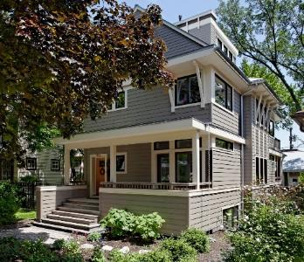
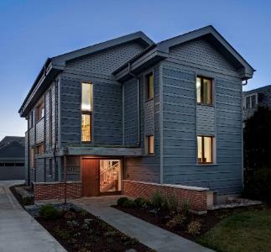
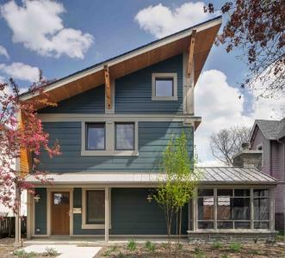
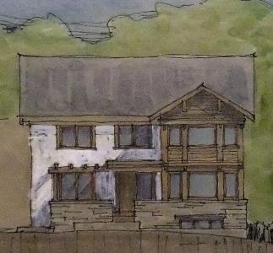
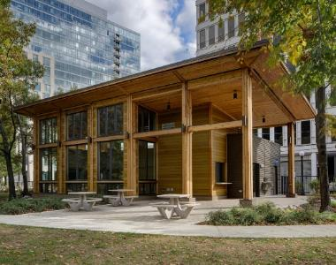
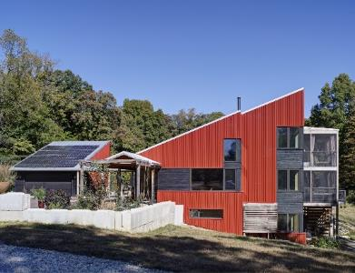
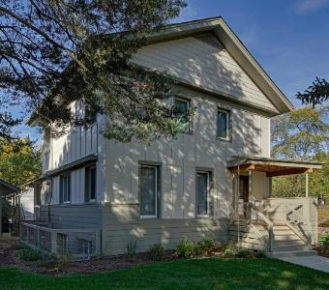
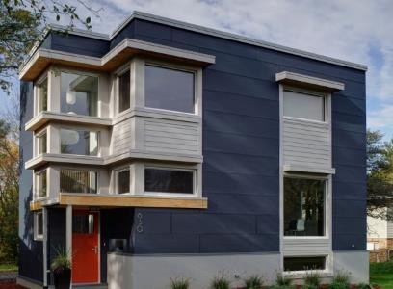
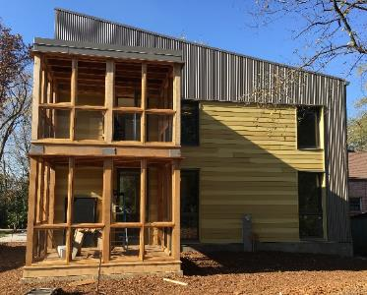
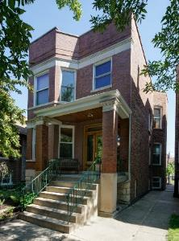
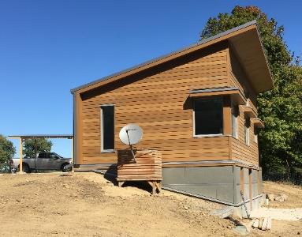
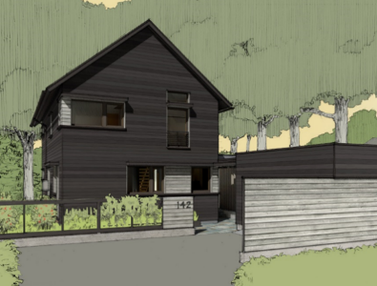
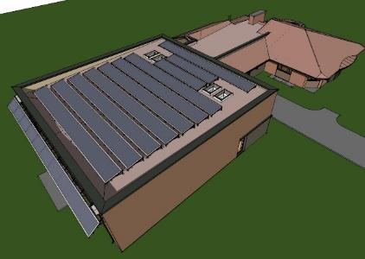
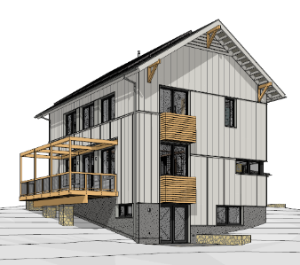
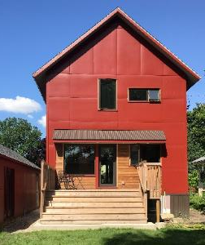
Most TBDA Zero Energy/Capable Projects, 2012-current

Slide 8
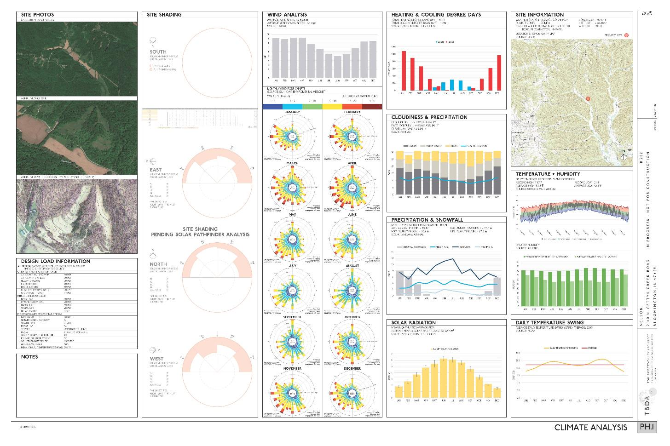
How?
Understand climate and site
Energy Model
Conserve (passive measures, design)
Produce (renewables)
Climate Analysis

Slide 9
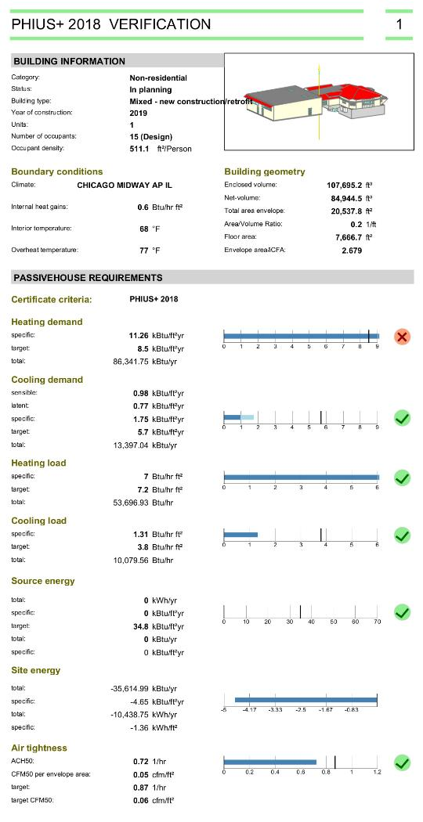
How?
Understand climate and site
Energy Model
Conserve (passive measures, design)
Produce (renewables)
WUFI-Passive model

Slide 10
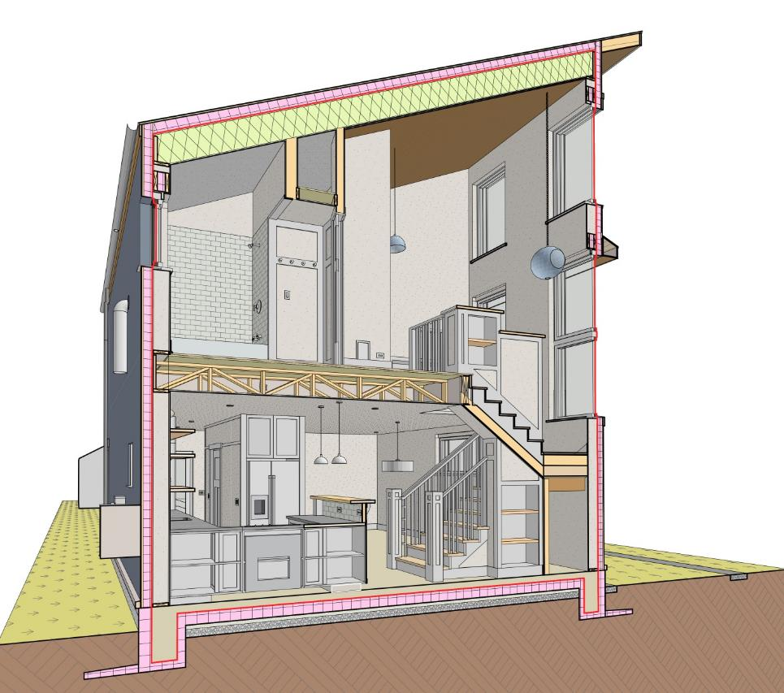
How: Design (PH)
Compact Form
Good Orientation
Airtightness Strategy
Plenty Insulation, and Avoid Thermal Bridges
Use Efficient Appliances and Lighting
Right-Sized Passive House, Oak Park, IL

Slide 11
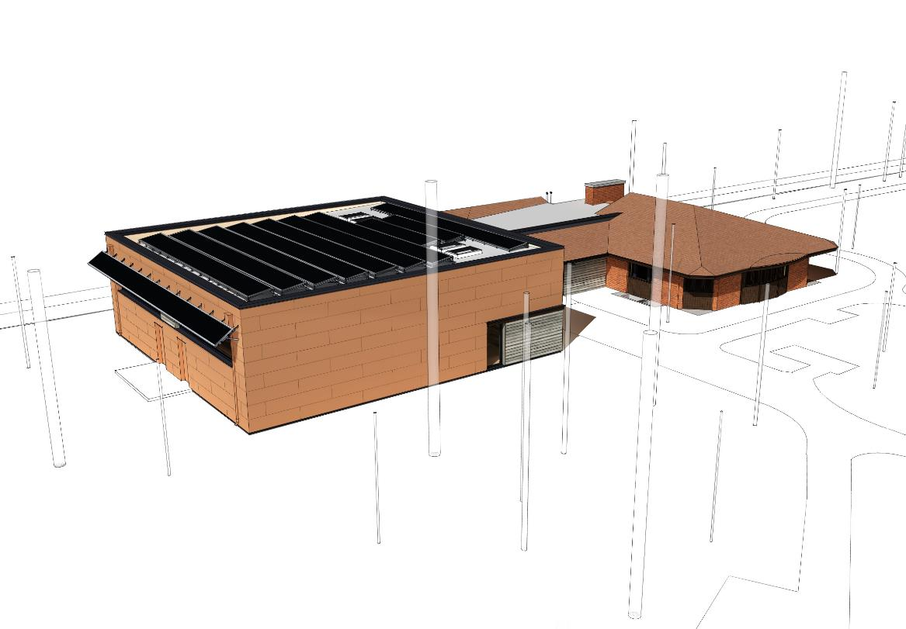
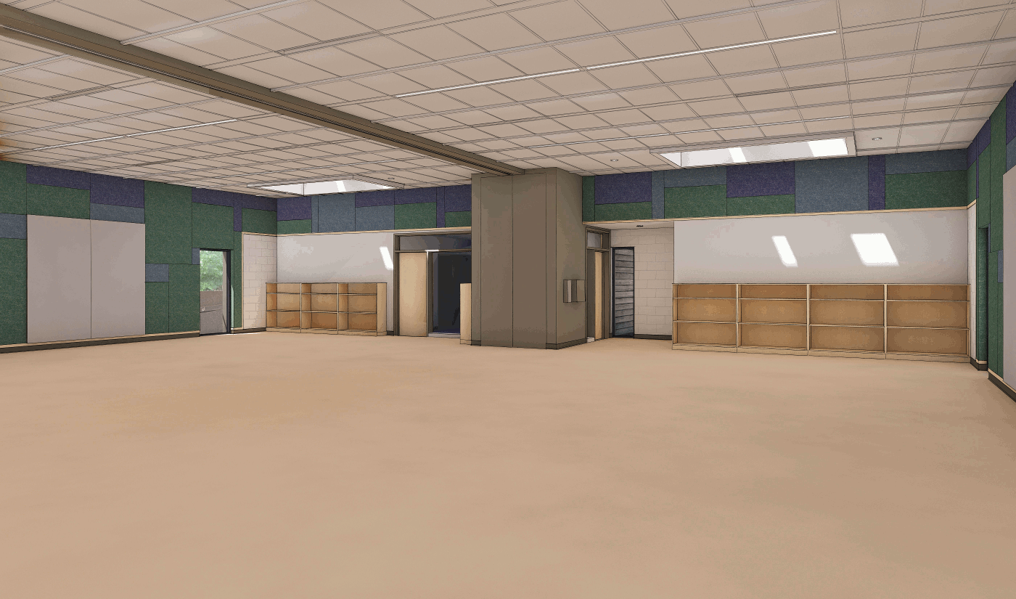
Case Study
Renovation of existing building
Addition of multi-use space
ICECF grant
Passive House for optimization of envelope
Solar PV array to offset annual energy
PDOP Carroll Center, Net Zero Passive House

Slide 12
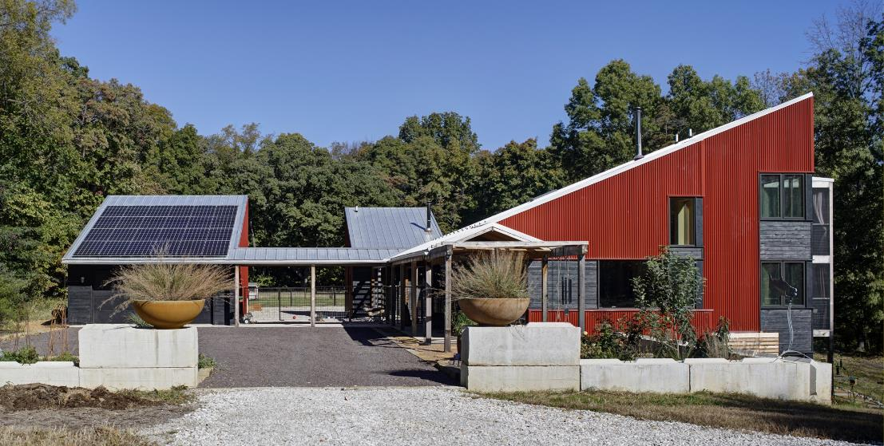
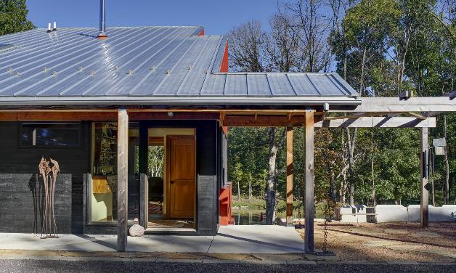
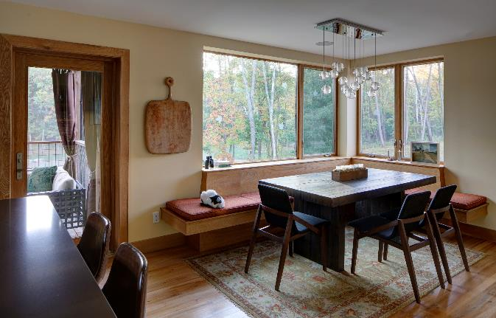
Case Study
33 acre site with restored prairie and new pond
Guest house detached for “low-power mode”
Net zero energy requested
Passive House measures, but LEED certification
Net Zero Prairie Retreat

Slide 13
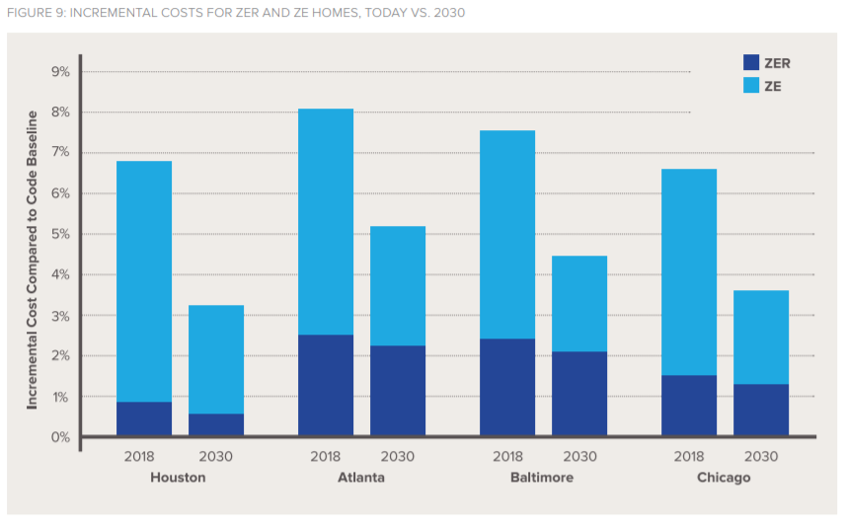
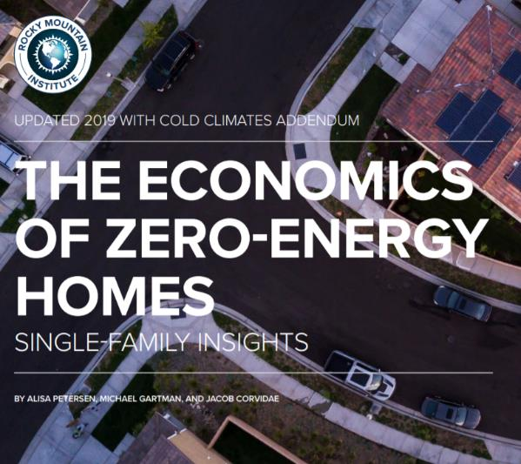
Attainability
Zero Energy Homes are affordable today. See RMI’s report:

Slide 14
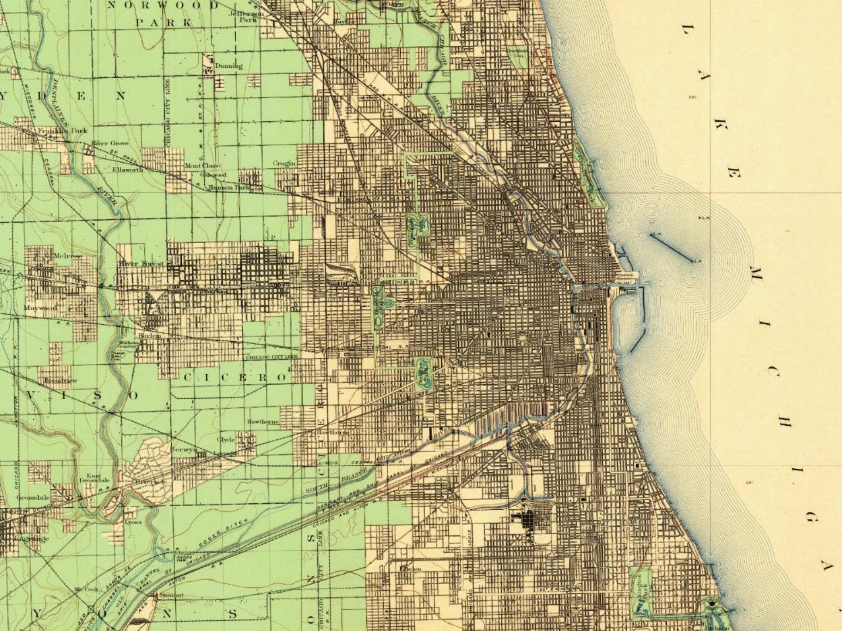
1901

Slide 15
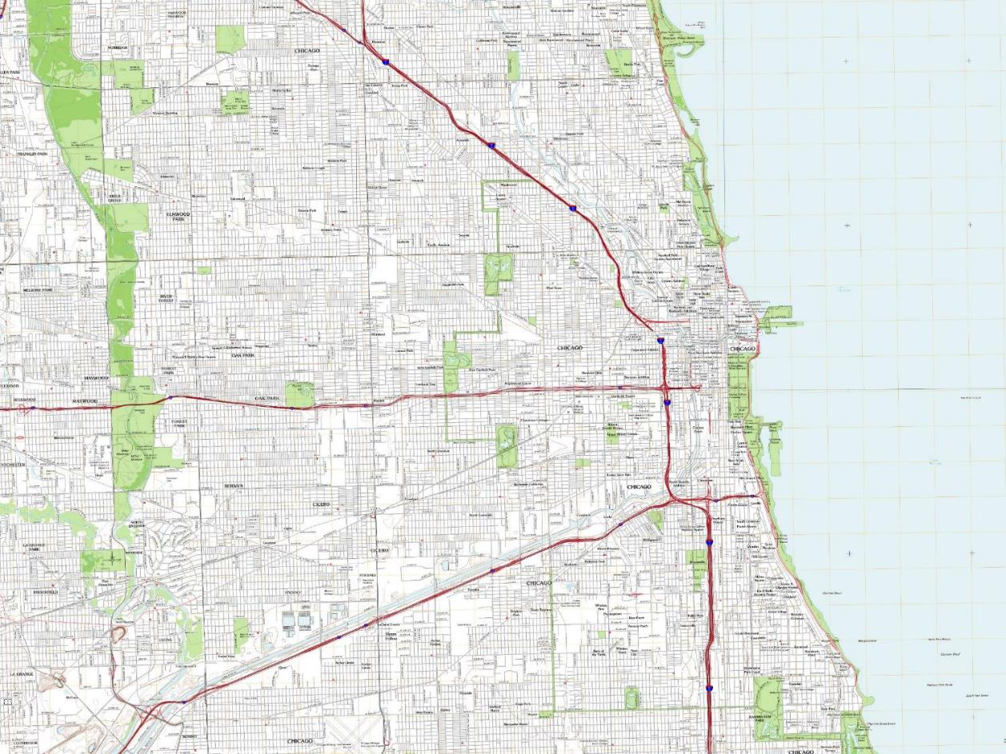
2011 …what should 2030 look like? Rapid change got us here, and rapid change is necessary and available.

Slide 16
Resources
Building Science Corporation: papers, insights, tools
Passive House Institute US (PHIUS)
Rocky Mountain Institute (Reinventing Fire, etc.)
Living Future Institute (Biophilic Design Initiative)
Stay tuned for Chicago 2050—April at Chicago Architecture Center and launch Earth Day 2020
Nature

