Slide 1
Net Zero Facilities
Case study on the Carroll Center Addition & Renovation
Net Zero Tips & Learned Experiences

Slide 2
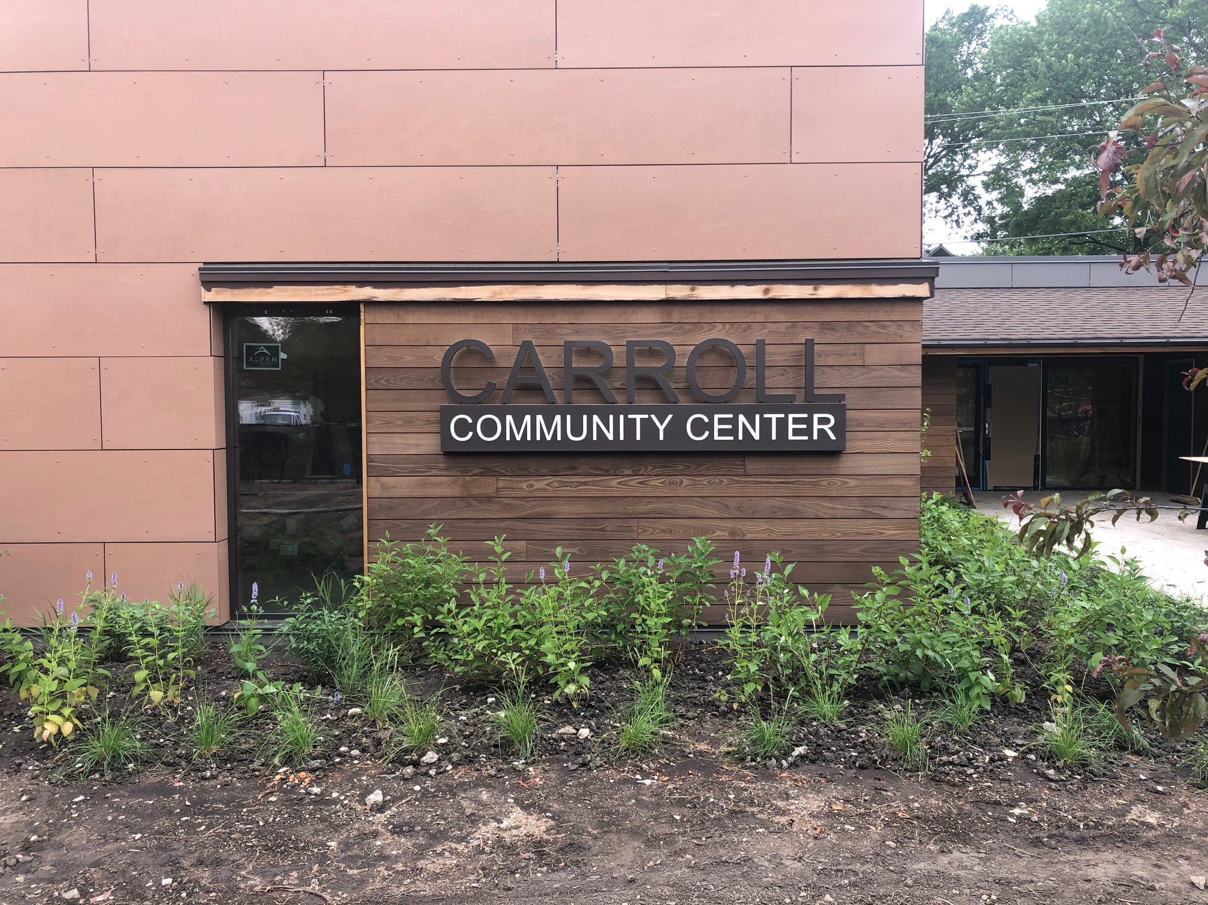
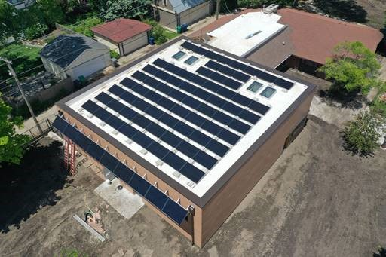
Carroll Center Addition & Renovation
Saved 100 year old facility and added on new programming space
Well thought out design (Layout, daylighting, solar exposure)
PHUIS + Source Zero Design
Received Grant funding for additional costs
Notes:
It is not just about designing a facility and doing the energy load calculations and solar capacity. That is the easy part. You must be sure that the constructability portion is done correctly. The building systems have to match the staff’s capabilities. Otherwise you will have sophisticated systems that will cost you more money to maintain with contracted labor.

Slide 3
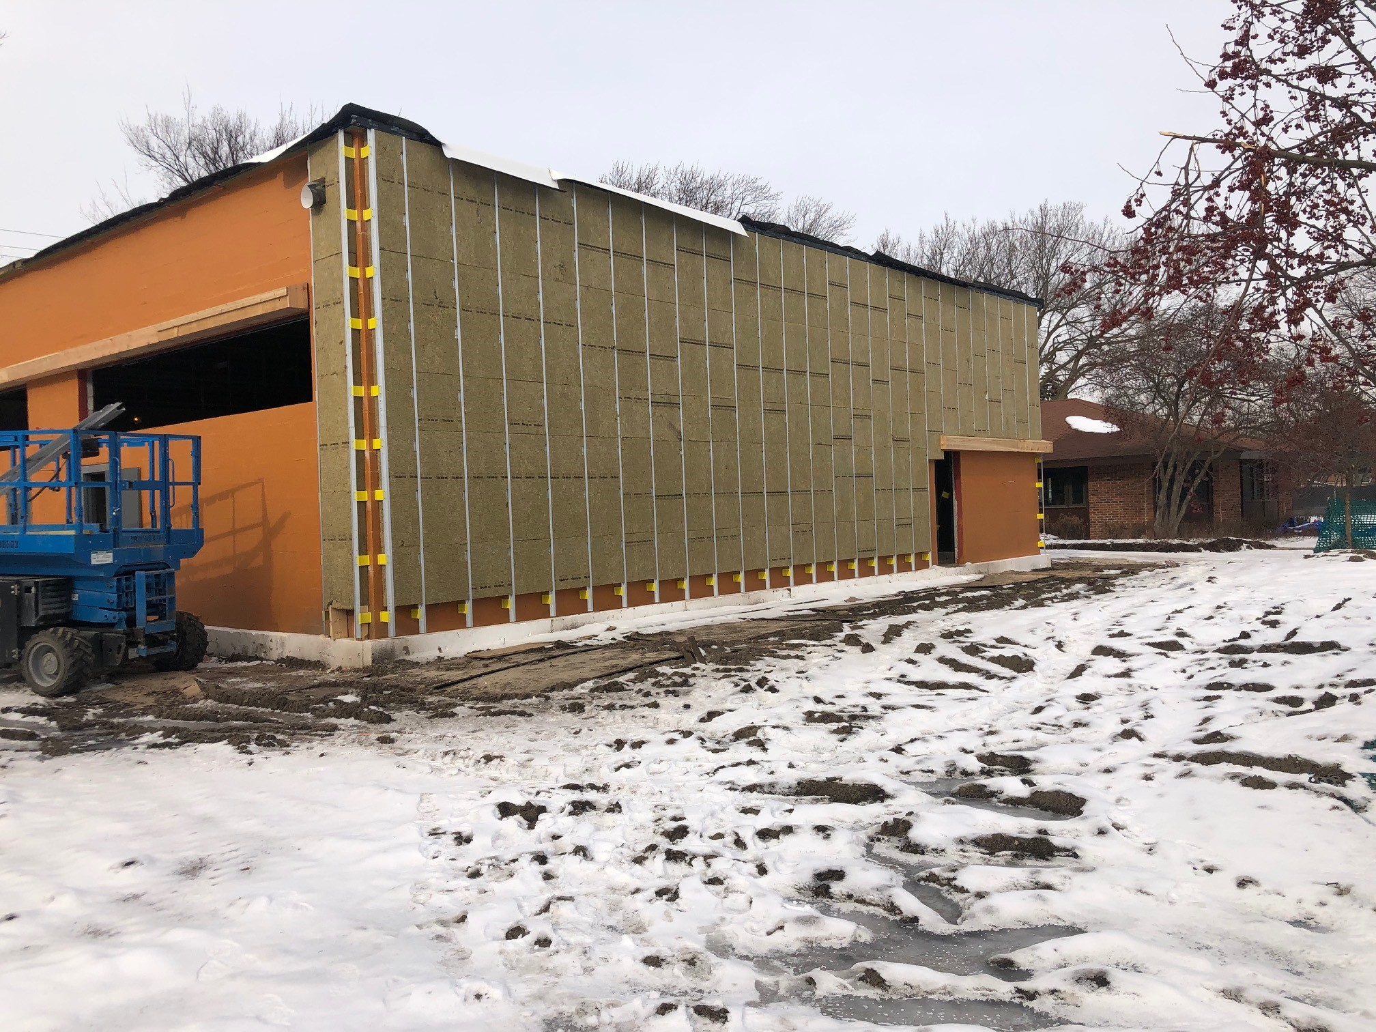
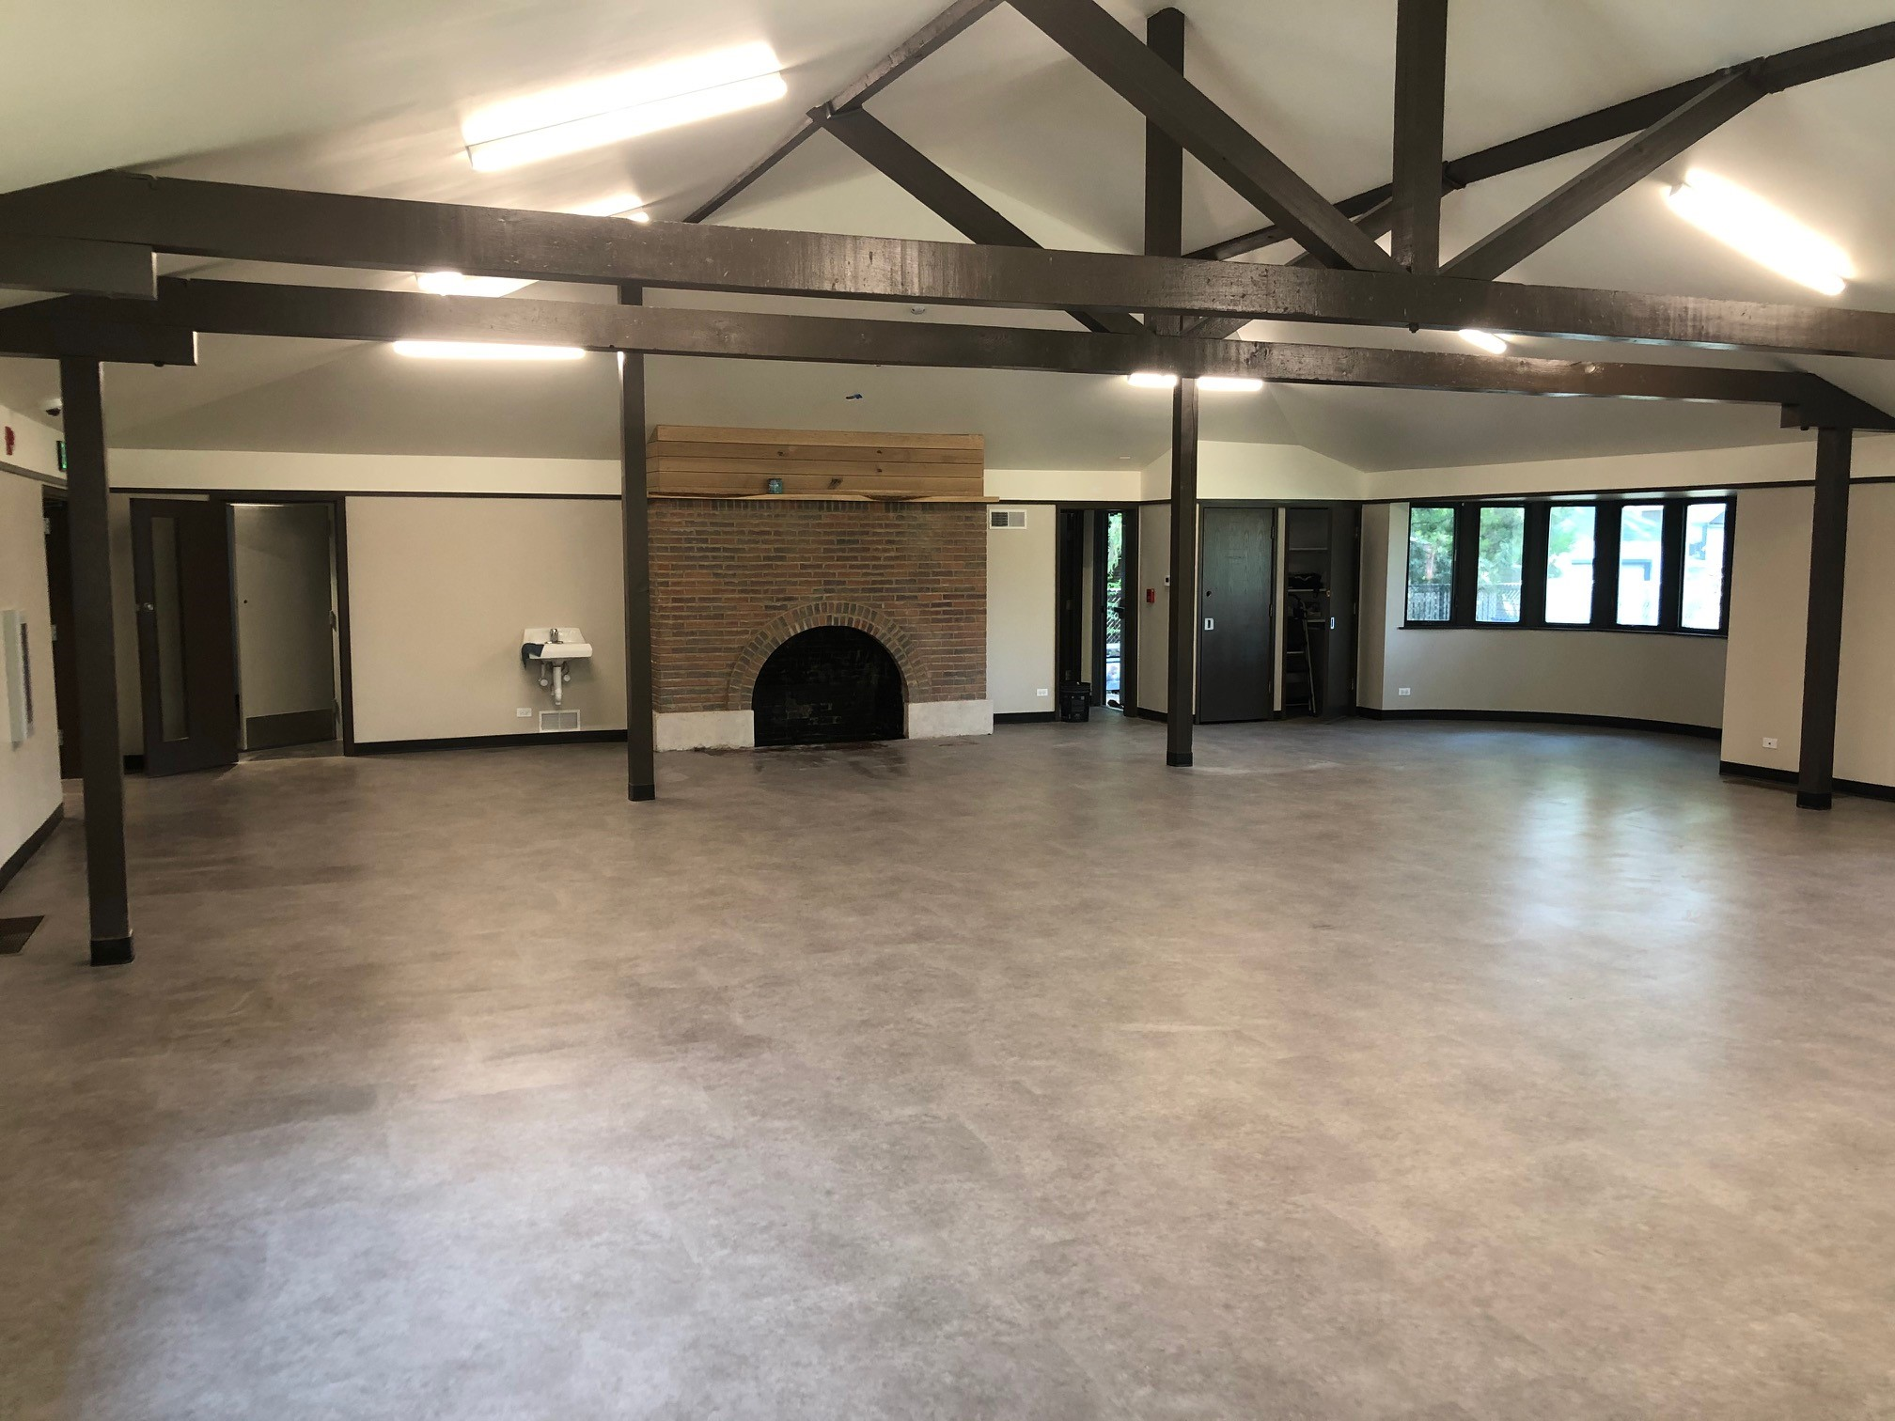
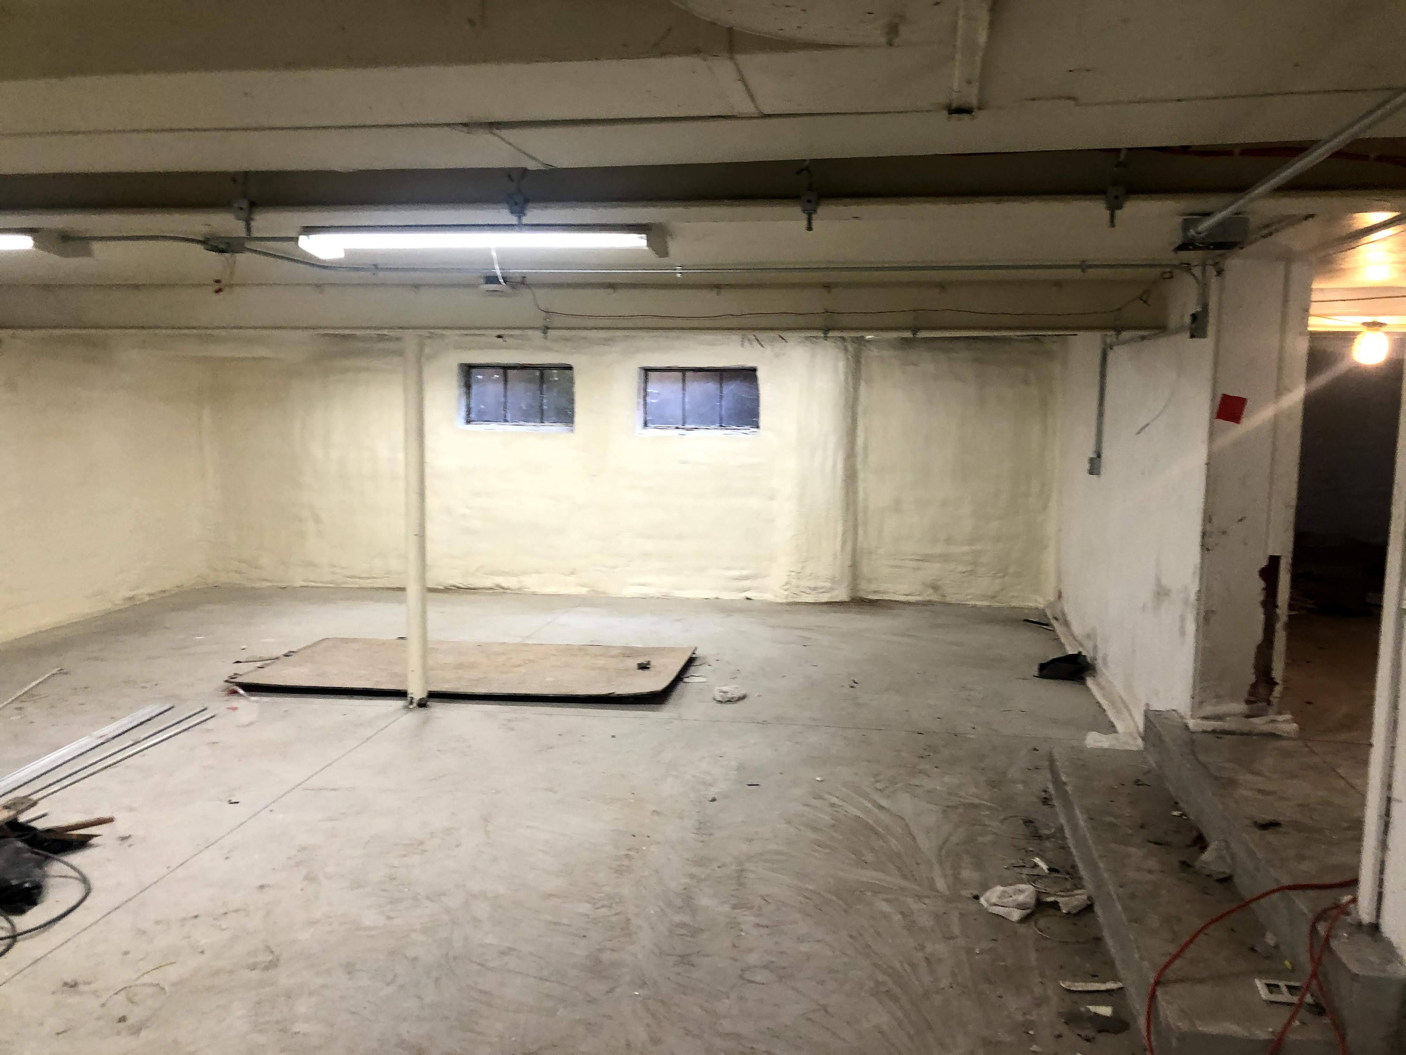
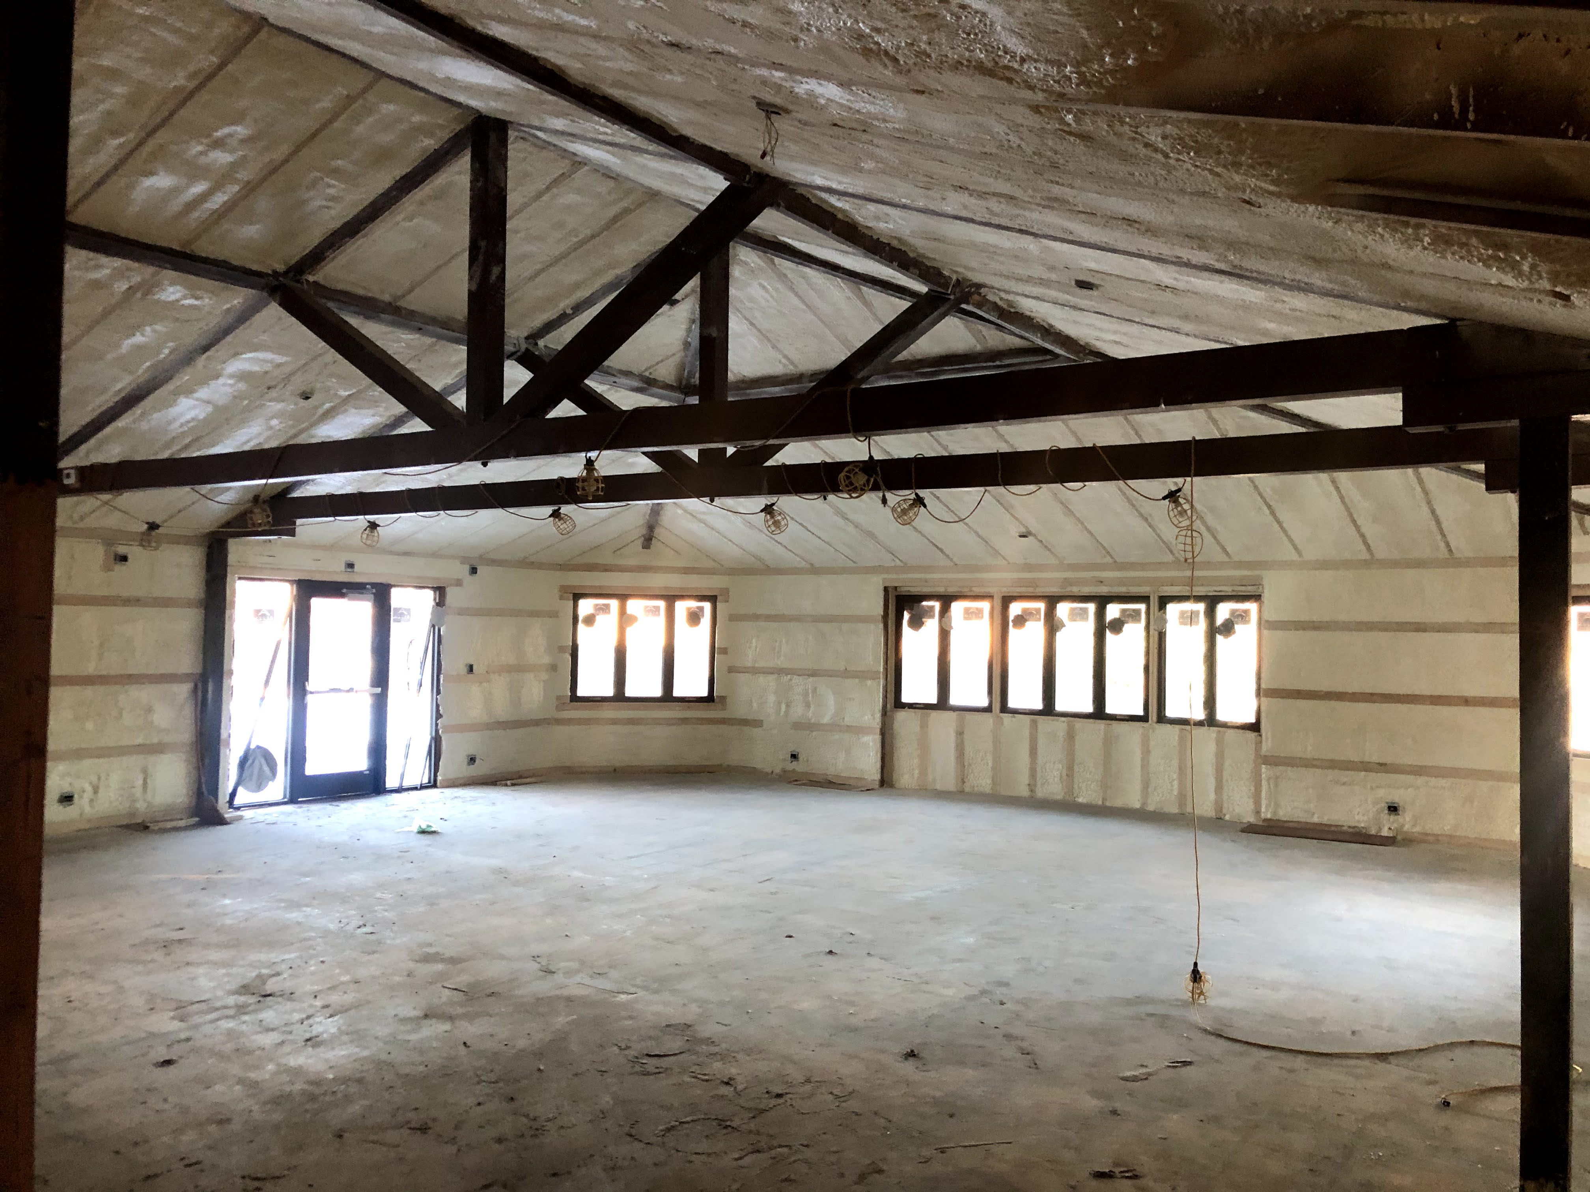

Slide 4
Electrical Load Monitoring

Slide 5
Solar PV monitoring

Slide 6
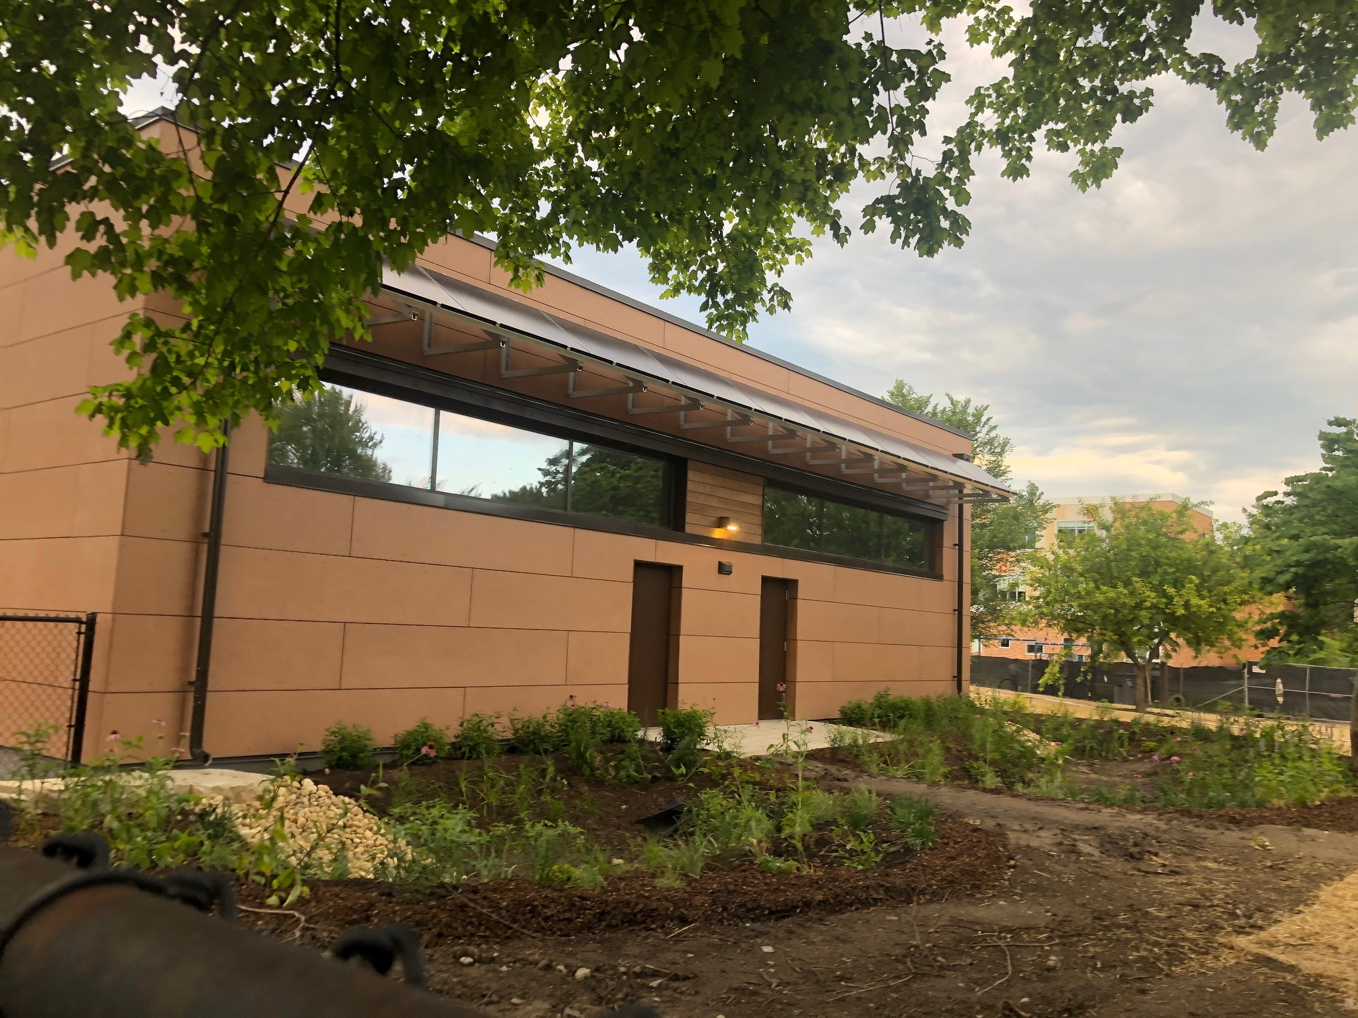
Post Construction
Maintenance Systems Trainings
Education and awareness training for all staff in the facility
Monitor…… Monitor….. Monitor
Tell your peers what worked and did not work.
Notes:
Maintenance staff needs to have trainings specific to the building components and monitoring software to be successful.
Key staff using the facility need to be educated on how the facility operates and the awareness of all energy usage. “Story about camp staff leaving the door propped open on a 90 degree day thinking it will help circulation”

Slide 7
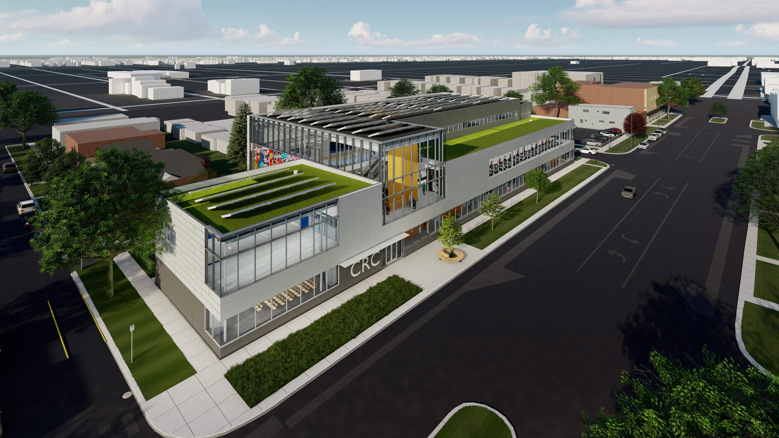
OAK PARK CRC
Fully Electric Facility
Net Zero
Will Save $80,000 annually on energy costs.
Notes:
Started as just an all electric facility with some sustainable features. Then the discussion of grant funding came into play and followed up with discussions with our Board moved towards a net zero direction.

