Slide 1
Why Reducing Carbon Emissions in Buildings Matters--and How to Do It
Fox Valley Sustainability Network | June 29, 2021

Slide 2
About Us
The Fox Valley Sustainability Network brings together the public and private sectors from around the Fox Valley to cut across boundaries and create a healthy, sustainable and vibrant Fox Valley.
FVSN is an ongoing entity that:
works on various climate change issues and projects
marries communications infrastructure with action- oriented events
connects the dots to create an environmentally sustainable region.

Slide 3
Fox Valley Sustainability Network provides opportunities to learn together, collaborate on sustainability planning and implementation, seek funding and report progress.
WHAT WE DO
If you would like us to make a presentation to your group or board, please contact Mackie Hill at mhill@a5inc.com.

Slide 4
We host six forums annually, attracting up to 125 people per
event covering such topics as renewable energy, adaptive reuse, local food and more.
4
500
COUNTIES
EVENT PARTICIPANTS
We connect people and organizations to raise awareness, educate and mobilize efforts around creating a healthy, sustainable communities — and a better Fox Valley region.
25
FVSN draws participants
from the counties of Kane, DuPage, McHenry and Will.
COMMUNITIES

Slide 5
Founding Partners

Slide 6
Core Team
Mavis Bates Kane County
Abby Beck City of Batavia
Gary Cuneen Seven Generations Ahead
John Harris a5 Branding & Digital
Mackie Hill a5 Branding & Digital
Vetia Hill
Elevate
Ivy Klee
Kane County
Karen Miller Kane County
Alex Minnella
City of Aurora
Jessica Mino
The Conservation Foundation
Maggie Soliz Applied Ecological Services
Natalie Zine Village of Oswego

Slide 7
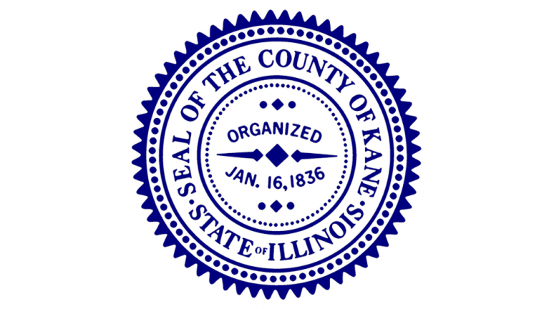
Sponsors

Slide 8
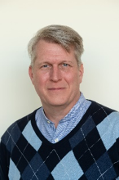
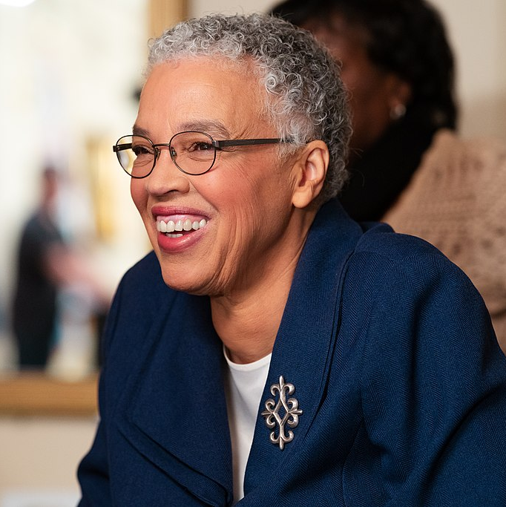
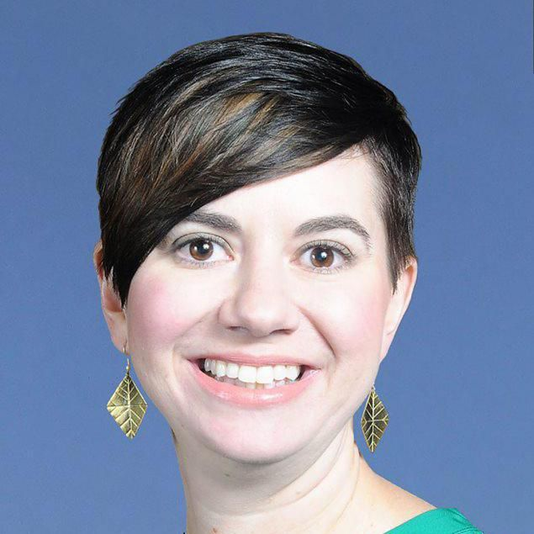
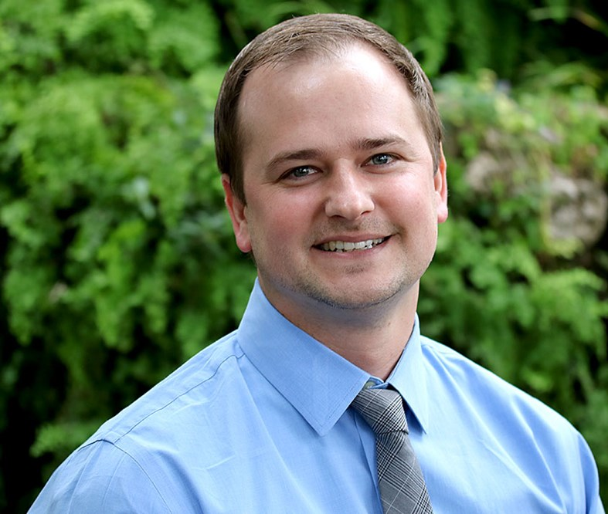
Speakers
Katy Kaluzny Associate Director, Illinois Green Alliance
Chris Lindgren Superintendent of Parks and Planning, Park District of Oak Park
David Pope President and CEO, Oak Park Resident Corporation

Slide 9
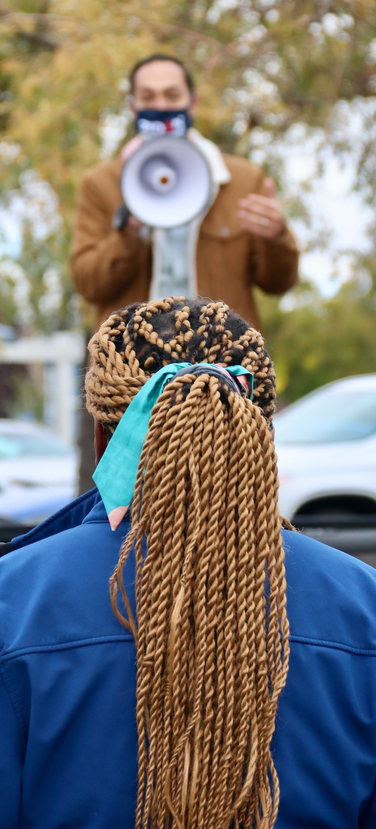
How To Stay Connected
To access tools, resources and upcoming events, like Fox Valley Sustainability Network on Facebook or visit:
www.foxvalleysustainabilitynetwork.com
www.facebook.com/foxvalleysustainabilitynetwork

Slide 10
Unplug Illinois Day, a program of the Illinois Park and Recreation Association, is coming to the Fox River Valley on Saturday, July 10.
Events
Elgin Park District, Oswegoland Park District and South Elgin Parks and Recreation District with Fox Valley Special Recreation Association will all be hosting events that encourage people to unplug from technology and plug into activity, adventure, exercise, family, nature and more!

Slide 11
Sponsors

Slide 12
Why Reducing Carbon Emissions in Buildings Matters--and How to Do It
Fox Valley Sustainability Network | June 29, 2021

