Slide 1
WASTE REDUCTION FORUM
Review of Kane County recycling & waste reduction initiatives
Jennifer Jarland, Kane County Recycling Program Coordinator
Curbside residential food scrap composting for municipalities
Jennifer Nelson, Senior Program Manager at Seven Generations Ahead
Founding Board Member, Illinois Food Scrap Coalition
Member, Illinois Wasted Food Solutions
Northern Illinois Food Bank waste reduction and food recovery work
Chad Steward, Food Sourcing Retail and Strategy Specialist
Notes:
JEN:
I’ll start with an Illinois Update on hospitals Reducing Wasted Food and Composting.
Then we’ll hear from Rush Oak Park Hospital on their Food Scrap Composting to Food Donation program, followed by Rush University Medical Center sharing how one program can encourage another and talk about their Surplus Project, how they’re Reducing Wasted Food and Feeding People. And finally we’ll hear from one of our speakers that has re-joined us from our last institution webinar from the University of Illinois at Chicago to talk about the Path to Hospital Food Scrap Composting.

Slide 2
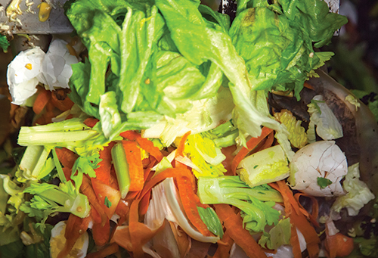
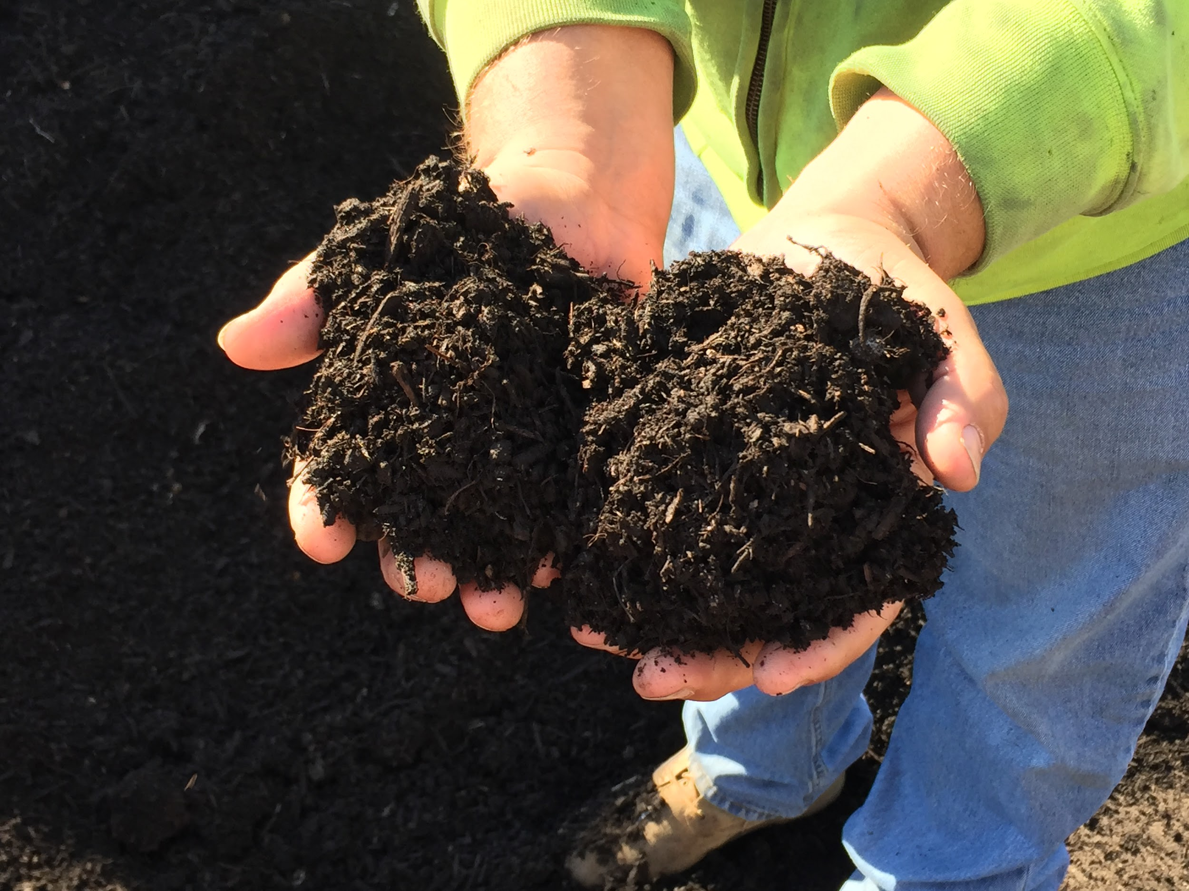
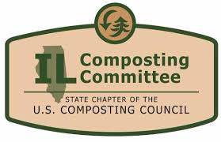
Fox Valley Sustainability Network
Waste Reduction Forum
May 23, 2019
Curbside residential food scrap composting for municipalities
Jen Nelson
Seven Generations Ahead
Illinois Food Scrap Coalition
Illinois Wasted Food Solutions Task Force
Notes:
Good morning and thank you for joining us for the FVSN Waste Reduction Forum. I have been asked to introduce the topic of reducing food waste through curbside residential composting for municipalities
My name is Jen Nelson and I work for Seven Generations Ahead, local environmental nonprofit, as our zero waste expert. Seven Generations Ahead is a 17 year old nonprofit serving Chicago and the region. Our mission is to promote the development of ecologically sustainable and healthy communities. For almost 2 decades, SGA has been supporting schools, institutions, businesses and municipalities in reducing waste as well as supporting the collaboration of multiple partners to lead Illinois to maximize food waste reduction, recovery and composting.
I am also a founding member of the Illinois Wasted Food Solutions Task Force. I am a Board Member of the Illinois Food Scrap Coalition.
In recent years, cities everywhere have begun to grapple with the problem of food waste. In the United States, where an estimated 40% of food is wasted each year, the problem is particularly acute. The US Environmental Protection Agency has recognized this problem in recent years by releasing a number of tools and programs including their Food Recovery Hierarchy, an online Excess Food Opportunities Map, the Food: Too Good To Waste Toolkit and Guide, and the Food Recovery Challenge. Taking the right steps now will help increase economic development, provide a healthier and safer environment and engage residents in sustainability.

Slide 3
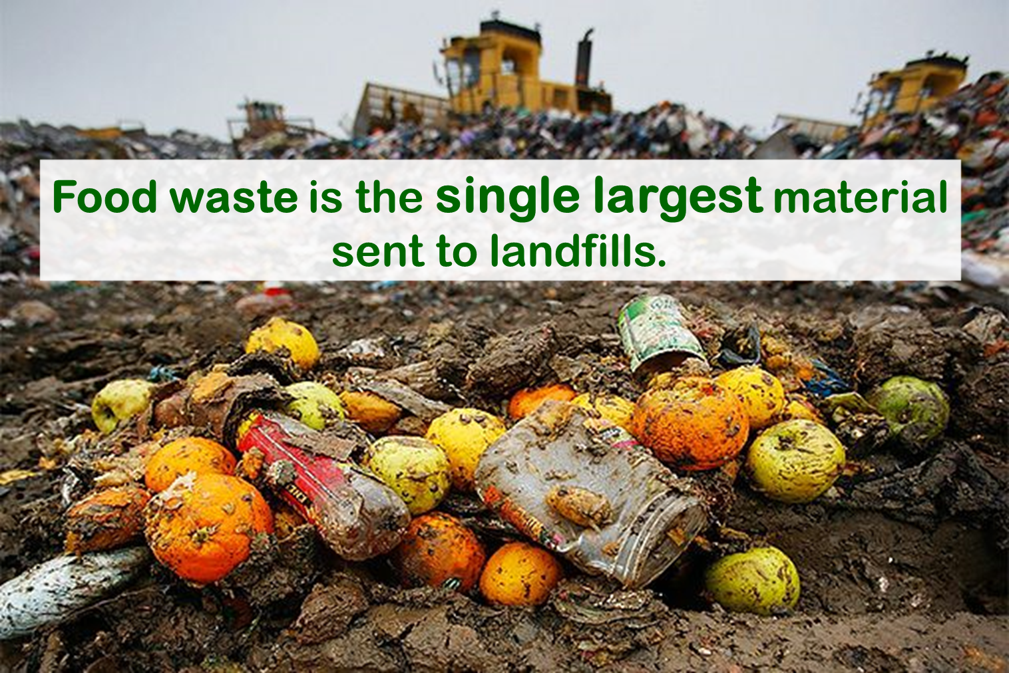
Photo credit: SCARCE

Slide 4
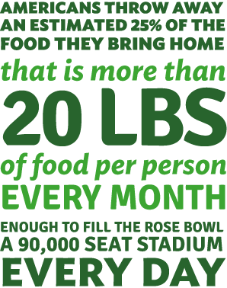
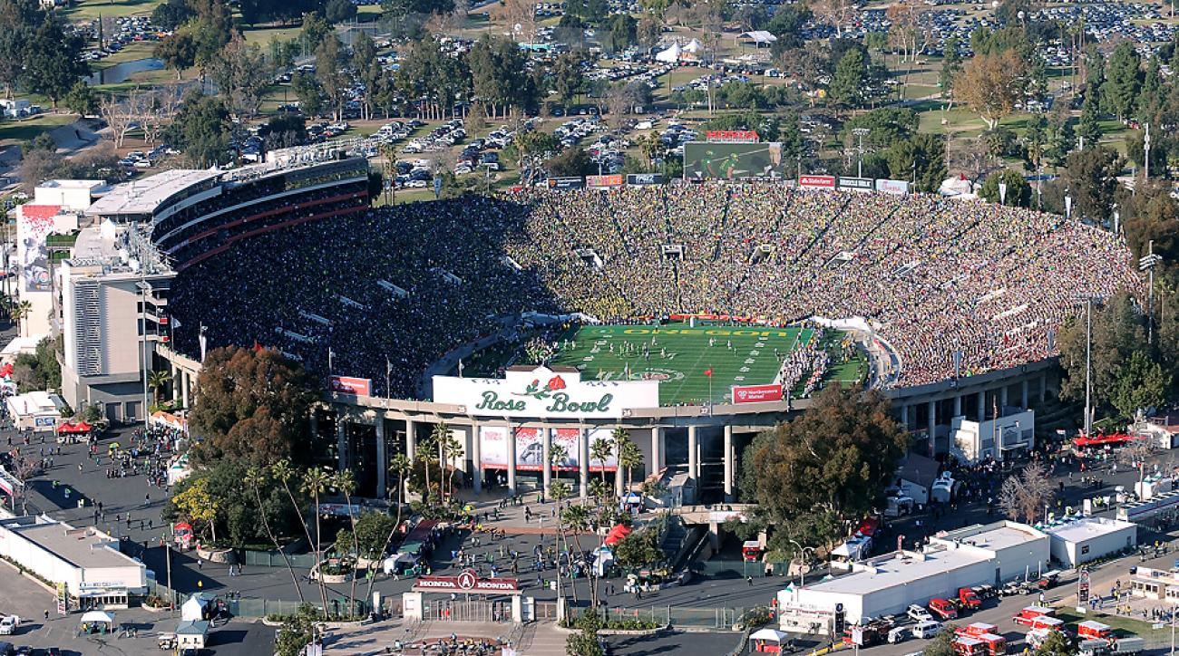
Notes:
Americans throw away an estimated 25% of the food we bring home.
This is equal to more than 20 pounds of food per person EVERY MONTH
It is also enough to fill the Rose Bowl (a 90,000 seat stadium) EVERY DAY
EVERY DAY!!!
And consumers are the most significant cause of food waste — more than grocery stores, restaurants, or any other segment of the supply chain. The largest segment of food waste comes from households allowing food to go bad.
That means we can all be part of the solution. Start today and see what you can do. This is one place where it really is true: Your actions do make a difference.

Slide 5
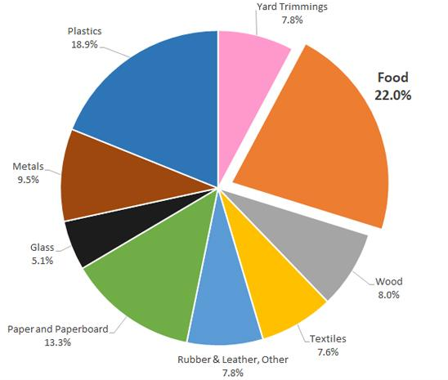
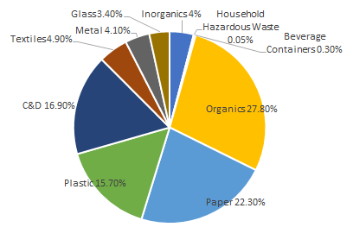
Food Waste is an
Illinois Problem
US: 22% of what is thrown away is food!
Illinois: 2.8 million tons of food are thrown away each year (nearly 20%)
Total MSW Landfill by Material, 2015
(137.7 million tons)
2015 Illinois Commodity/ Waste Generation
and Characterization Study Update
Notes:
So do these national numbers fit with what we are dealing with in Illinois? Absolutely and unfortunately.
In the United States, 22% of what is thrown away is food.
Illinois landfills 14 million tons of waste annually, and nearly 20% of that is food scraps 2.8 million tons each year!
Landfill life expectancy in Illinois is approximately 20 years, at 2017 disposal rates, barring capacity adjustments, until capacity is depleted state-wide. For the region around the Chicago Metro area, this life expectancy is as low as 11 years. Reducing food waste, donating and composting are critical to help avoid the need for the development of more landfills and solid waste facilities, and food waste will be a big part of the solution.

Slide 6
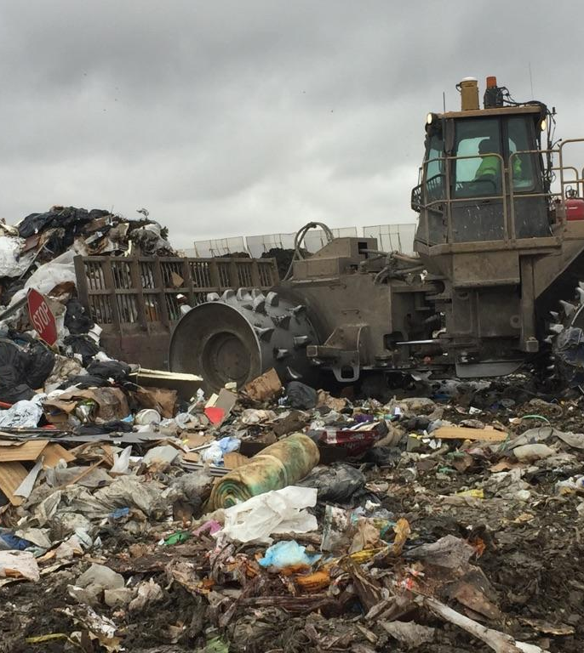
Illinois Waste Management
14 million tons of waste landfilled annually
3.4 million tons of compostable organics
nearly 20% of what is landfilled is food scraps
Of all compostable organics generated, only 15% were composted
59% of all yardwaste
only 1% of all food waste
Illinois landfill life expectancy is 20 years
2015 Illinois Commodity/ Waste Generation
and Characterization Study Update
Notes:
As the population grows and generates more solid waste our landfill capacity is rapidly decreasing. Landfill life expectancy in Illinois is approximately 20 years, at 2017 disposal rates, barring capacity adjustments, until capacity is depleted state-wide. For the region around the Chicago Metro area, this life expectancy is as low as 11 years. Reducing, recycling and composting waste is critical to help avoid the need for the development of more landfills and solid waste facilities. Taking the right steps now will help increase economic development and provide a healthier and safer environment and to engage students in sustainability education and operations.
I want to paint a picture of how Illinois is currently managing waste disposal and food scrap composting to set the stage for our discussion.
LANDFILL DATA
Illinois landfills 14 million tons of waste annually, and nearly 20% of that is food scraps
Of all compostable organics generated, only 15% were composted (59% yard, and only 1% food)
On the bright side, Illinois has already established the building blocks for successful food scrap composting programs. Chiefly, Illinois has existing yard waste composting infrastructure and is home to 50 compost facilities, over a dozen of which accept food scraps in addition to yard waste. While Illinois has no mandates that enforce waste diversion targets or ban food scraps from landfills, the state does require composting of yard waste but not food scraps.

Slide 7
Municipal Opportunities
Municipalities can play a key role:
reducing food waste
recovering/donating food to feed hungry neighbors
recycling/composting food scraps
procuring compost for stormwater management; construction, municipal landscape projects
educating community members about reducing food waste
Notes:
RESOURCES: State collaborations supporting food waste reduction, donation and composting: Illinois Food Scrap Coalition, Illinois Wasted Food Solutions Task Force, Fresh Taste, IL EPA, etc Municipal role – review hauler contract to determine if ride along program is available; future hauler RFPs to include quote for organics/composting service Municipal role - identify opportunity for municipal drop off program for food scraps (permanent or temporary) Municipal role - develop and support resident education and engagement campaign Municipal role – Incorporate BMPs from USEPA on stormwater management
Learn from other municipalities Identify key partners What do your residents want? What do your institutions and businesses want? Look at your hauler contract and those of your municipalities What are the costs and benefits?

Slide 8
Municipal Opportunities
Municipalities can play a key role:
reducing food waste
recovering/donating food to feed hungry neighbors
recycling/composting food scraps
procuring compost for stormwater management; construction, municipal landscape projects
educating community members about reducing food waste

Slide 9
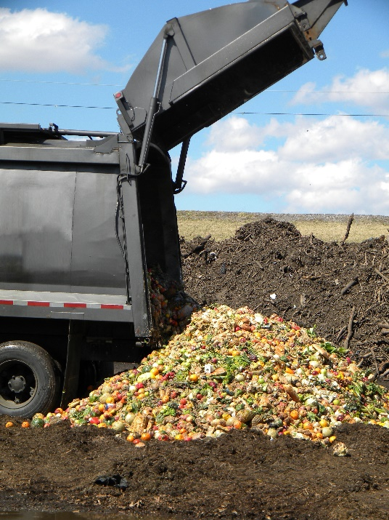
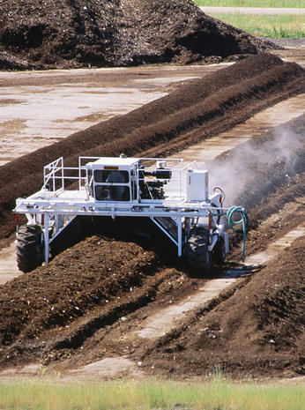
Commercial Food Scrap Composting
1. Sort food scraps
2. Haul to a compost facility
3. Food scraps decompose
4. Finished compost sold
Notes:
Composting is the natural process that converts organic material into nutrient-rich soil. Composting allows our post consumer food to shift from waste to a vital resource for soil. Although many municipalities across the nation have begun composting organic material, there is still a ways to go until it is mainstream. Whether you want to be a front runner in Illinois’ shift to composting or follow a plan already proven to be successful in other areas, this guide will help you uncover a strategy best for your municipality. Across the nation, composting is developing as a viable, locally-based industry that achieves multiple objectives related to economic development, job creation, cost savings, and environmental sustainability.
So what has changed in Illinois that led to the rapid development of municipal food scrap composting programs? Policy and infrastructure growth has been coupled with an increasing demand for this service.
So what is commercial food scrap composting?
With commercial composting, all food scraps and food-soiled paper is collected (this includes meat, dairy, bones, greasy pizza boxes, etc).
Then it’s hauled to a composting facility where the food scraps decompose and finished compost is sold commercially.
Since ALL food scraps can be collected with commercial composting, this type of composting generally results in a much greater waste diversion than on-site composting. And it is easier for people to sort and for institutions to have systems that collect food scraps with very little contamination.

Slide 10
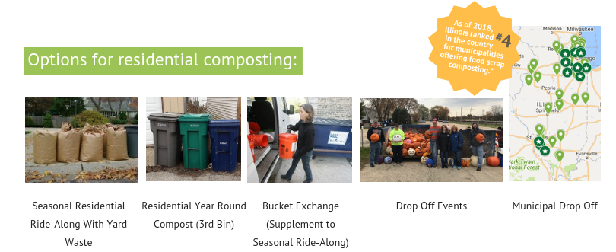
Municipal Food Scrap Options
Collection of food scraps (compostable food-soiled paper, compostable serviceware and other organic wastes) sometimes through adding these to an existing yard waste collection program.
Notes:
Seasonal Residential Ride-Along With Yard Waste Bucket Exchange (supplement to seasonal ride-along) Residential Year Round Compost (3rd Bin) Municipal Drop-Off Drop-Off Events
The majority of Illinois municipal residential programs are what can be called seasonal ride-along programs. This means that food scraps ride along with yardwaste.
Seasonal Residential Ride-Along With Yard Waste Description: This program allows residents to include compostable material in their existing yard waste container, which is picked up between April and November. Pros: Residents add food scraps to their yard waste without having to add any bins; No route changes made for haulers Cons: Only seasonal; Increased contamination potential; If there is no financial incentive, more education will be needed for residents; Critters and smell Example: Supplement to Ride Along for Winter Months Description: Businesses that provide door-to-door pickup of food scraps during the period it is not available with yard waste. These scraps are then taken to a commercial compost site. Pros: Easy for residents to participate Picked up weekly or biweekly Clean bucket is provided with each pick up Includes multi-unit buildings, restaurants and commercial businesses Cons: Increased contamination potential If there is no financial incentive, more education will be needed for residents Critters and smell Example: Residential Year Round Compost (3rd Bin) Description: A curbside yard waste ride-along pick up is when landscape waste is collected with the city’s weekly collection program. Homeowner’s dispose of their yard waste in a clearly labeled bag or bucket each week similar to their recycled and landfill waste. Since organic materials are already being picked up by haulers, a seamless transition into adding food scraps to these bins can result in efficient and sustainable disposal of organic material. Pros: Easy for residents because they simply put their waste outside similar to their current system of disposal Reduce Landfill Pickup Frequency Raise awareness of trash/ more education Year-round pickup Cons: Increased contamination potential Critters and smell If there is no financial incentive, more education will be needed for residents (https://www.opb.org/news/blog/ecotrope/the-pros-and-cons-of-curbside-composting-in-portland/) Collaborate closely with haulers to establish a compost pickup schedule that complements existing collection schedules, which may be more difficult to establish since it requires greater intervention on behalf of the hauler in organizing their trucks, pickup schedules, and compost facility drop-offs. Example: Municipal Drop-Off Description: This program requires a drop-off site where residents bring their food scraps. There are many different options for these sites like street corners or public spaces. This drop off can also be a one-day event or on a regular basis. Pros: Provide an opportunity for education about the importance of food scrap composting Decreases contamination Coordinating a select number of drop-off locations may be easier to coordinate with local haulers Year-round composting Many local sites accept compost drop-offs Cons: Inconvenient for residents Low participation rate Example:
BENEFITS
There are reduced costs for having food scraps ride along with yard waste: - The hauler can use the same truck that already has a route to haul yard waste. - Organic materials go to the same processing facility so there are reduced transportation costs and impacts.
CHALLENGES:
- Yard waste services are often not year round so residents either stop composting in the winter or there is a need for additional infrastructure and cost to continue the program.
- Not all compost processing facilities accept food scraps.
- Not all compost processing facilities operate year round

Slide 11
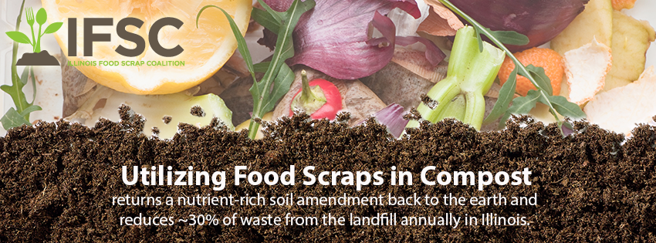
www.illinoiscomposts.org
Notes:
The Illinois Food Scrap Coalition is a coalition of community and government organizations, businesses, schools, institutions, service providers and processors throughout the state that are dedicated to advancing food scrap composting in Illinois. IFSC is also the Illinois Composting Committee of the US Composting Council.
We Compost is a free recognition program through the IFSC that supports Illinois municipalities, restaurants, institutions, businesses, and schools that are doing commercial food scrap composting. We Compost works to share best practices and promote these businesses.
www.illinoiscomposts.org

Slide 12
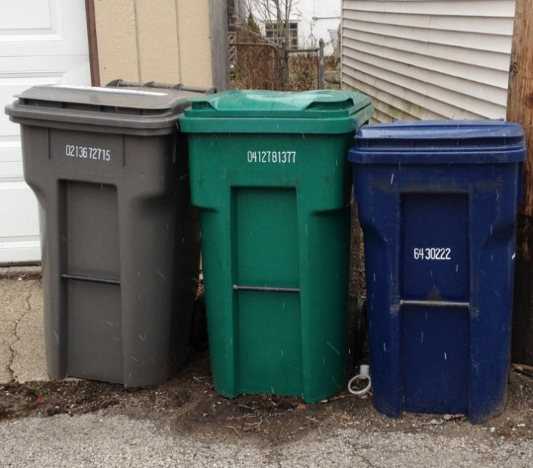
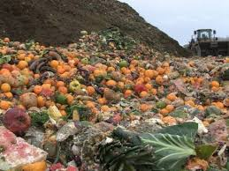
Food Scrap Composting
in Illinois
45 IEPA permitted compost processors
12-14 of these accept food scraps
187 We Compost partners
restaurants, institutions, businesses, schools and municipalities compost food scraps
30 Municipal food scrap programs
State policies enacted to support hauling and processing of food scraps
Notes:
6 years ago most “experts” in Illinois said we would not have residential composting – that it was just a “West Coast thing”. Things have changed significantly since then impacting both infrastructure and policy that allow for cost effective food scrap composting.
1990
Landscape waste was banned from landfills in Illinois in 1990. There are many landscape waste composting facilities and jobs in Illinois as a result of this effort. Currently there are:
50 IEPA permitted compost processing facilities, over a dozen accept food scraps http://epa.illinois.gov/topics/waste-management/permitted-facilities/compost-facilities/index
2009 - permit requirements for Commercial Food Scrap Composting were lowered in 2009, making this type of business more accessible for Illinois.
2015 - HB437 was passed to allow for temporary and permanent sites to collect organics for composting.
187 We Compost Partners
41 businesses
11 grocery stores & farmers
9 institutions
30 municipalities
45 restaurants & caterers
51 universities & schools
Illinois currently has 30 municipal residential food scrap composting programs, the 4th largest number in country.

Slide 13
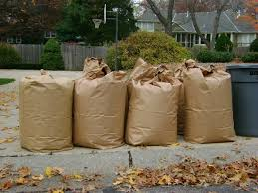
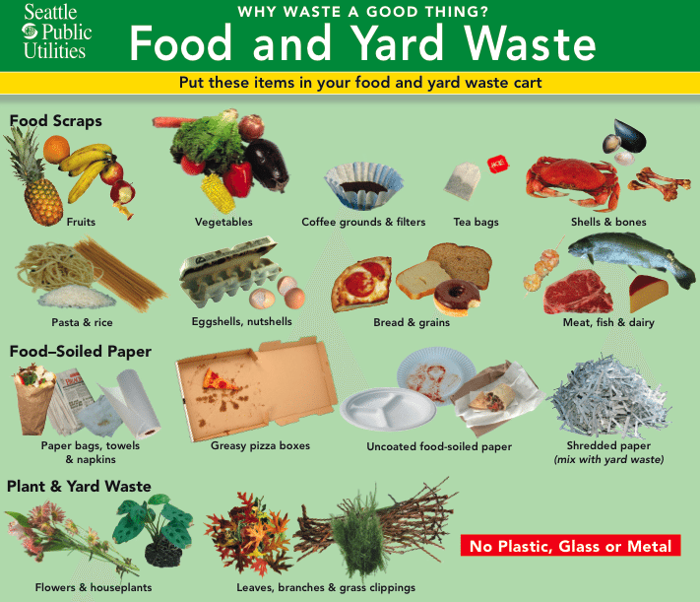
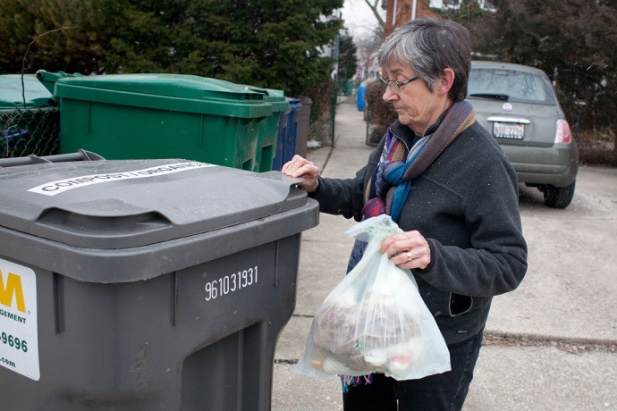
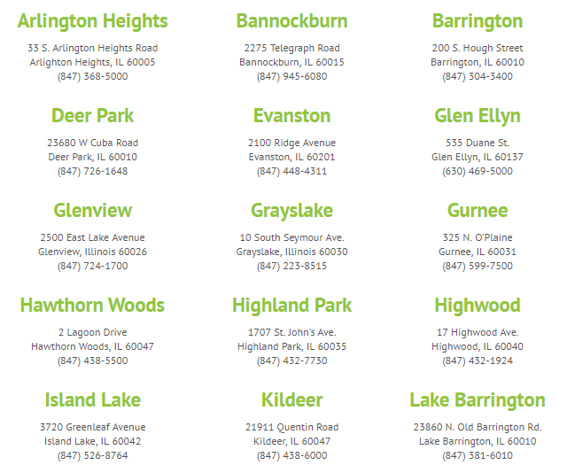
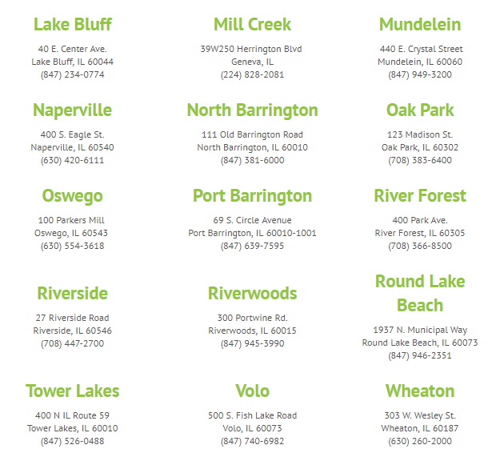
Illinois Municipalities with Residential
Food Scrap Composting
Notes:
These 30 municipalities are recognized as We Compost partners for providing residential food scrap composting. For some, this may include a 3rd bin to accompany landfill and recycling. For others it may be a program through which food scraps ride along with yardwaste during the yard waste season.

Slide 14
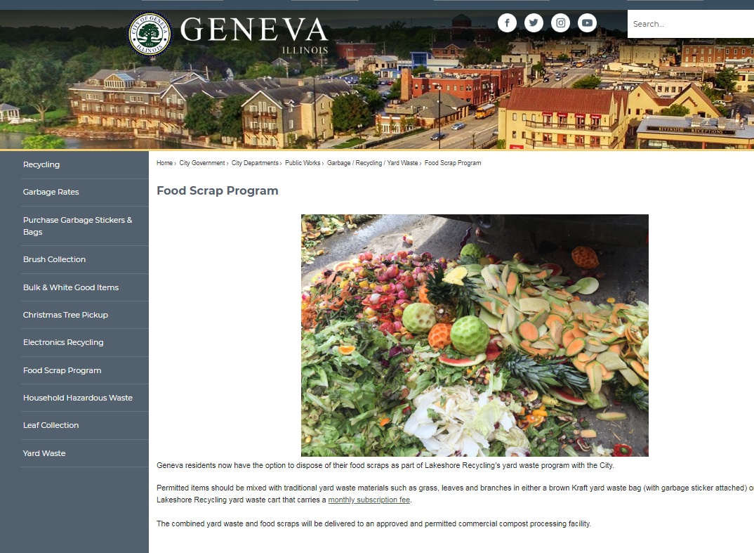

Slide 15
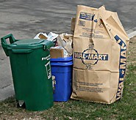
Food Scrap Collection Options
Year round organics collection as part of base service
In 2017, residents in Highwood and Lake Bluff became the first residents in the State with year round organics collection in a third cart, as part of the base service. This is not an opt in program, all residents are charged for the service and were provided a container to participate in Highwood.

Slide 16
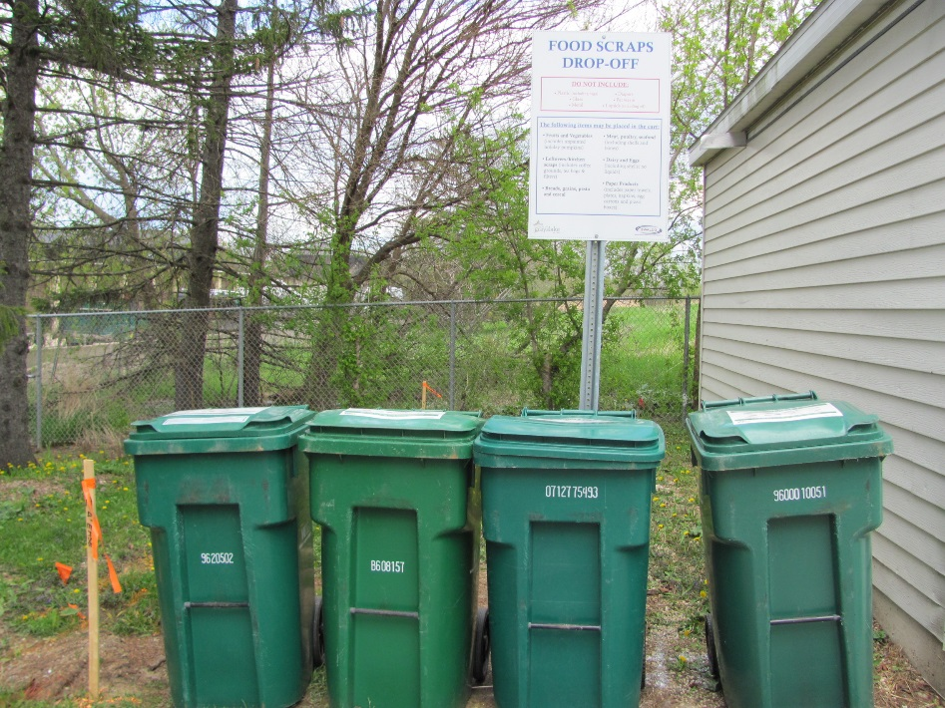
Food Scrap Collection Options
Recycling Center Food Scraps Drop-Off Service
Starting May 1st, 2016 the Village of Grayslake’s Public Drop Off Recycling Center begin accepting food scraps, the first such year round drop off in the State. This is a FREE service to residents of Lake County.
A second drop off for food scraps is provided by Prairieland Disposal at its office located in Lake Barrington.
Village of Gurnee added a drop off in its latest contract extension, will open in 2019.

Slide 17
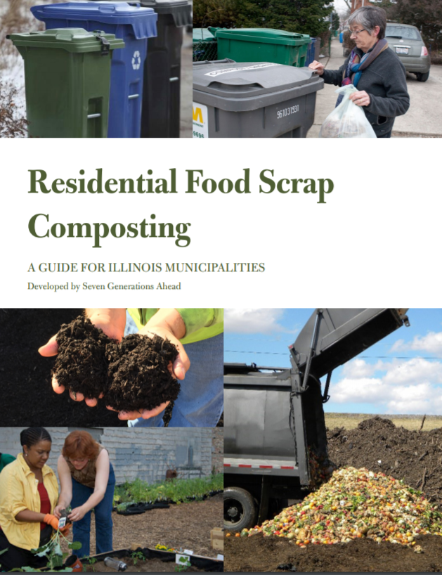
Illinois Municipal Guide to Residential
Food Scrap Composting
Get the Dirt on Illinois Composting
start and grow a residential compost program

Slide 18
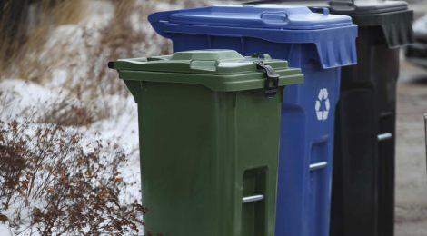
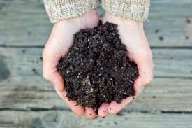
Municipal Guide Topics
Municipal composting options
Steps to take: planning and engagement
Is your municipality ready?
Partners and programs
Education and engagement
Potential challenges and solutions
Compost procurement
Appendices
Benefits to composting
Hauler contracts
Best Practices: Illinois case studies
Notes:
In order to support municipalities considering food scrap composting programs, we are collaborating with the IFSC, SWALCO, SWANCC and others to develop a Municipal Guide to Commercial Food Scrap Composting. A Municipal Guide is in development to document and share strategies and resources to encourage municipal food scrap composting
Steps to Take: Planning and Engagement Is Your Municipality Ready? Composting programs vary from community to community and are impacted by the available infrastructure. Urban, suburban and rural settings offer different infrastructure and economics. Overview of existing state, county and local policy.
Partners and Programs: Contract language and partner collaboration; Education and Engagement: communication strategy, best practices, sample communication pieces Potential challenges and solutions: case studies and solutions related to resident engagement and the “yuck factor”, contamination and cost
Compost Procurement: Compost procurement guide
Best Practices: Illinois case studies comprehensive survey of existing Illinois municipal programs
This guide is being shared today as well as with a broader group of municipalities seeking input into its effectiveness.

Slide 19
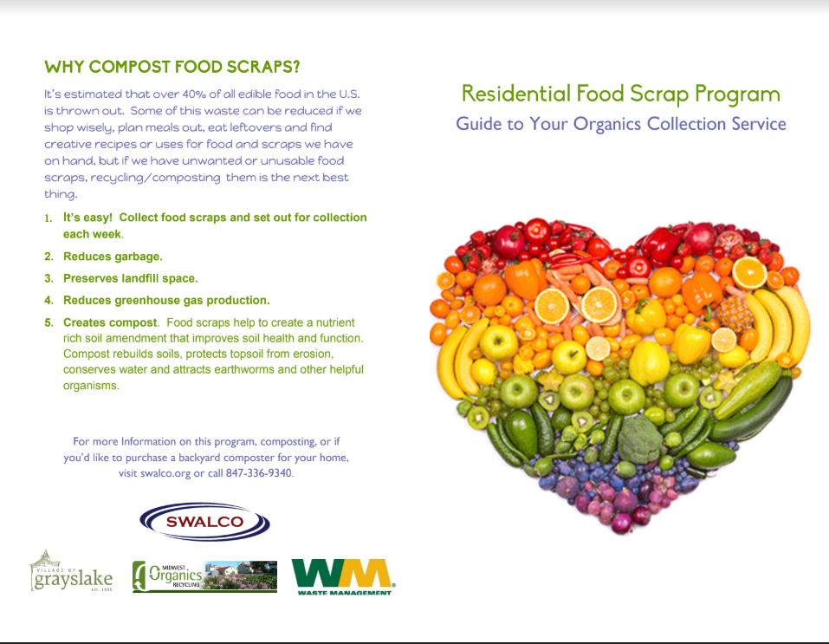
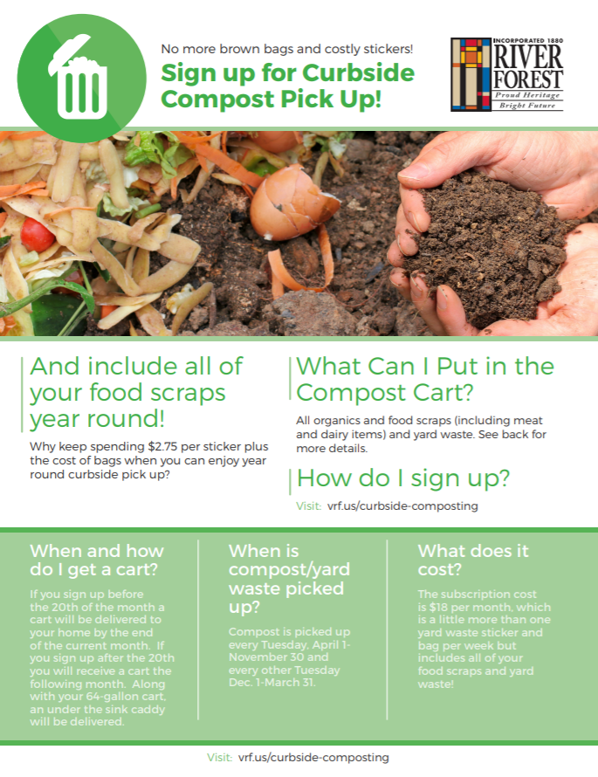
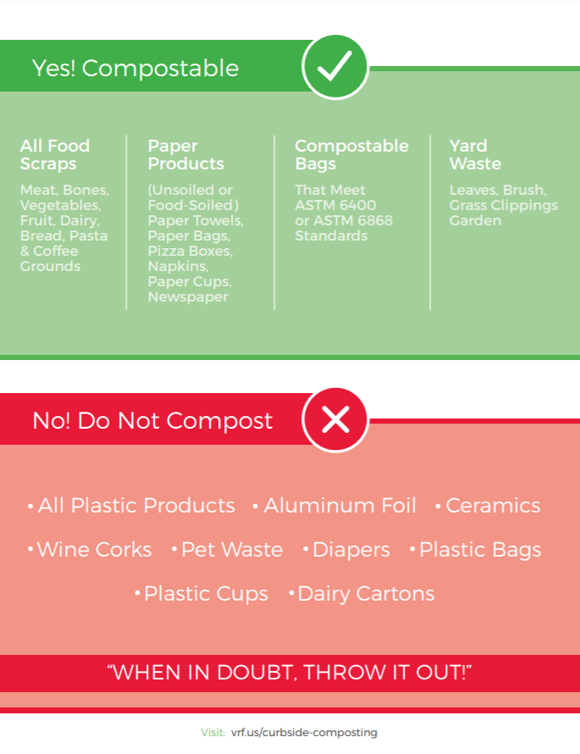
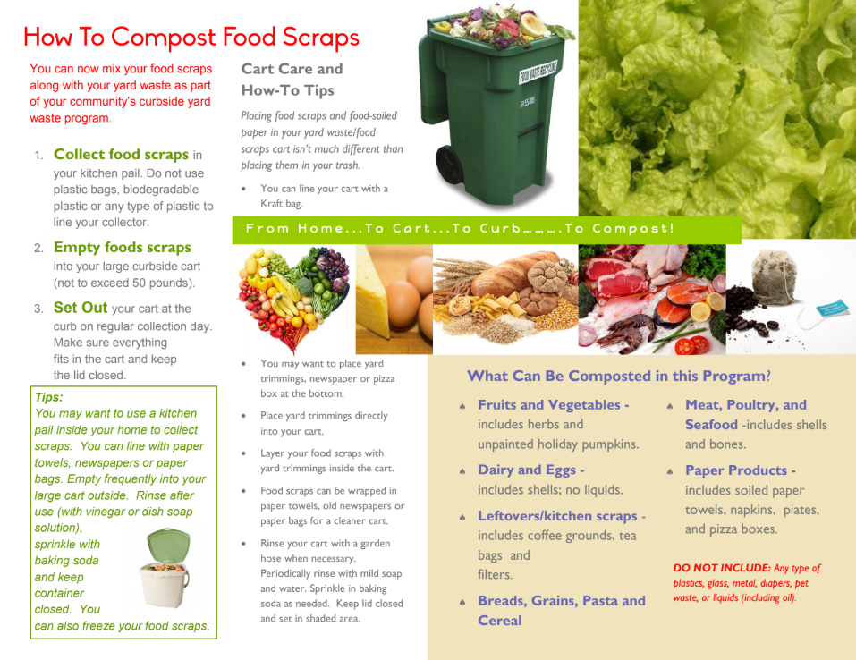
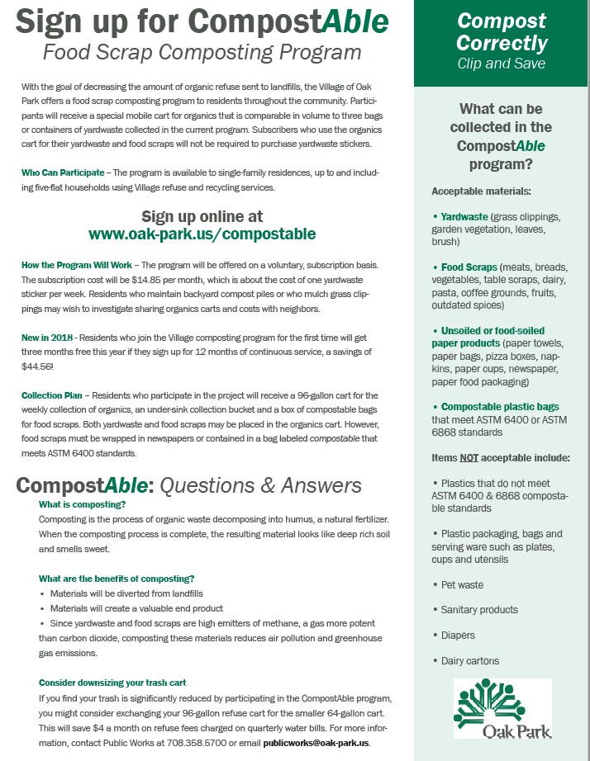
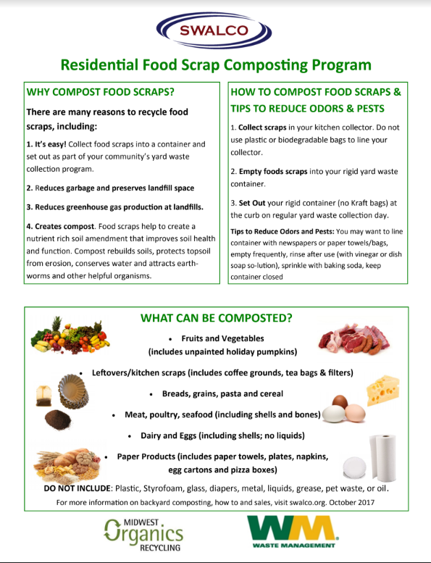
Education and Engagement

Slide 20
Possible Municipal Ordinances and Practices
Create a waste reduction policy or goal for city government (procurement, energy, waste diversion, recycling, composting)
Create a food donation policy for city government cafeterias, events, conferences
Provide incentives to businesses that donate leftover food
Conduct a waste audit of any local government institutions to identify opportunities to reduce, donate, recycle and compost
Notes:
RESOURCES: State collaborations supporting food waste reduction, donation and composting: Illinois Food Scrap Coalition, Illinois Wasted Food Solutions Task Force, Fresh Taste, IL EPA, etc

Slide 21
Next Steps for FVSN Municipalities
Assess options for residential compost program:
Review hauler contract to determine if ride along program is available
Future hauler RFPs to include quote for organics/composting service
Identify opportunity for municipal drop off program for food scraps (permanent or temporary)
Develop and support resident education and engagement campaign
Incorporate best management practices (BMPs) from USEPA on stormwater management
Notes:
RESOURCES: State collaborations supporting food waste reduction, donation and composting: Illinois Food Scrap Coalition, Illinois Wasted Food Solutions Task Force, Fresh Taste, IL EPA, etc

Slide 22
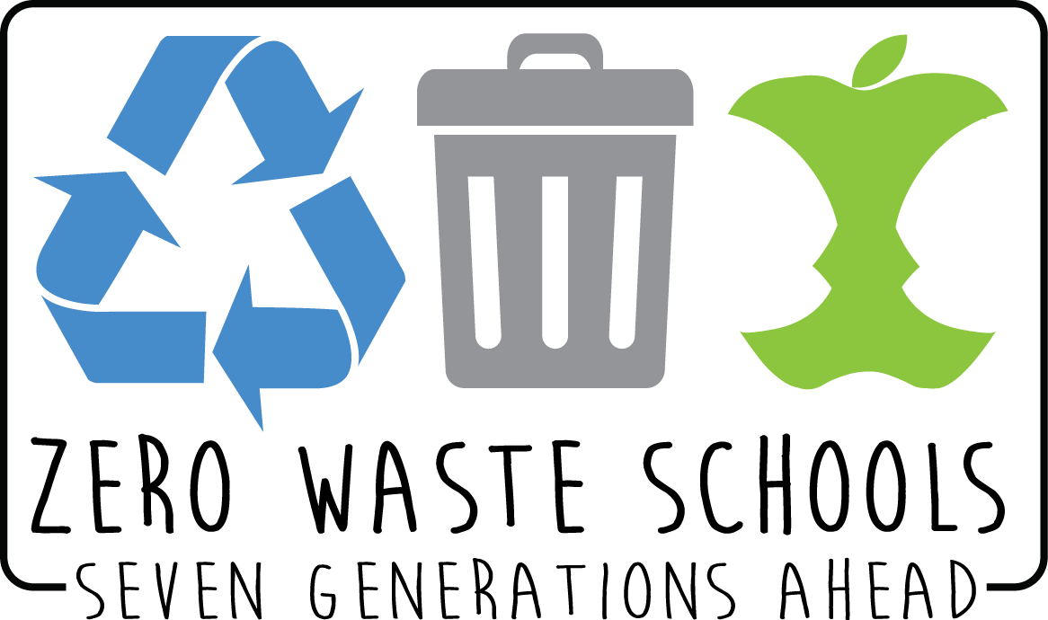
Project Name:
Building Illinois’ Local Food Shed Through Advancing Food Scrap Composting
Funder:
Funded through the Searle Funds at The Chicago Community Trust, Food:Land:Opportunity is a collaboration between Kinship Foundation and The Chicago Community Trust.
Partners:
Illinois Food Scrap Coalition, Illinois Green Economy Network, Illinois Environmental Council, Illinois Wasted Food Solutions Task Force
Notes:
Much of our work in this arena is thanks to multiple years of funding for our project Building Illinois’ Local Food Shed Through Advancing Food Scrap Composting. We currently have grant funding to support counties and municipalities in assessing their waste reduction opportunities related to composting food scraps. As part of this process we are working with counties in Northern Illinois to share information on the role counties can play supporting municipal food scrap composting
The project’s long-term goal is to expand local, sustainable Illinois food production through development of a viable food scrap composting industry. The project is working to create demand for food scrap composting through education, policy and pilot projects, while driving infrastructure development and targeted investments. This presentation is one of a series being done to share information to reduce food waste and encourage donation and composting across multiple sectors.

Slide 23
Jen Nelson
Seven Generations Ahead, Senior Program Manager
Illinois Food Scrap Coalition, Board Member and Education Committee Chair
Illinois Wasted Food Solutions Task Force, Member
jennifer@sevengenerationsahead.org
Thank you!
Notes:
Thank you for joining us and

