Slide 1
Public and Private Sector New Construction November 21, 2019 Presented by: Hanh Pham
Notes:
Introductions
Inquire about the disciplines of the staff in the room.
How many of you have participated in any of ComEd’s EE programs?

Slide 2
ComEd Energy Efficiency Program New Construction
INTRODUCTION
OFFERING BASICS
TECHNICAL ASSISTANCE
CASE STUDIES
ELIGIBILITY
WRAP UP
Xavier Apartments, Photo by Mark Ballogg

Slide 3
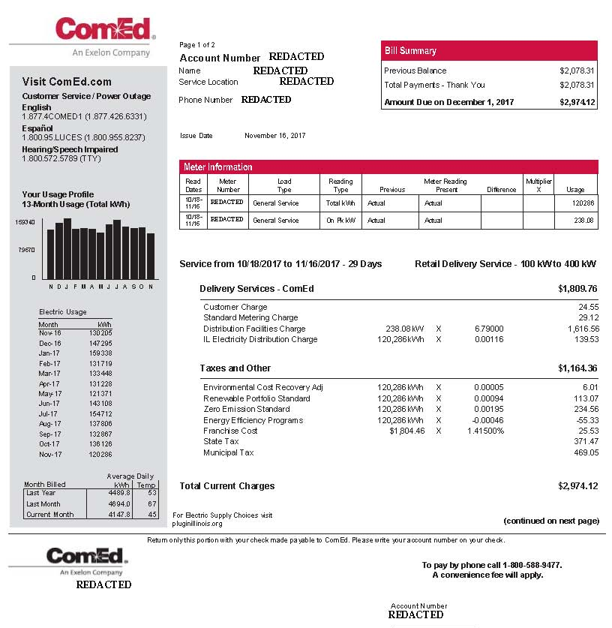
This Program is Funded by You!
Charge on the monthly bill for all ComEd and gas utility customers
Based on kWh and therm usage
Photo courtesy of Roosevelt University
Photo courtesy of Roosevelt University
Notes:
All ComEd and gas utility customers contribute to the incentive fund.
Take a look at your ComEd bill. There is a line that says “Energy Efficiency Programs” and shows what your company is contributing.
It’s based on kWh usage (and therm usage on your gas bill).
Since you’re paying into the fund, you should consider energy efficiency projects that will repay you in incentives.
Supplemental info: The rate # can change, the 00046 changes based on year and regulations

Slide 4
Energy Efficiency Offerings Portfolio-wide
Technical Assistance
Incentives
Discounts
Optimization
Facility
Laboratory
Healthcare
Data Center
Combined Heat and Power
Process Efficiency
New Construction
Standard
Custom
Small Business Energy Savings
New Construction
Business Instant Lighting Discounts
Business Products Discounts
Retro-commissioning
Rooftop Units
Compressed Air
Industrial Refrigeration
Process Cooling
Energy Tool
BEA (Building Energy Analyzer)
ComEd.com/BizIncentives
Notes:
ComEd has a large portfolio of energy efficiency offerings, NC is just one of them you can see on this list.
ComEd has programs and services that appeal to virtually ALL SIZES & TYPES businesses…
Everything from:
instant discounts on lighting
to cash incentives to Assessments
to whole-building solutions
to help businesses use energy more efficiently

Slide 5
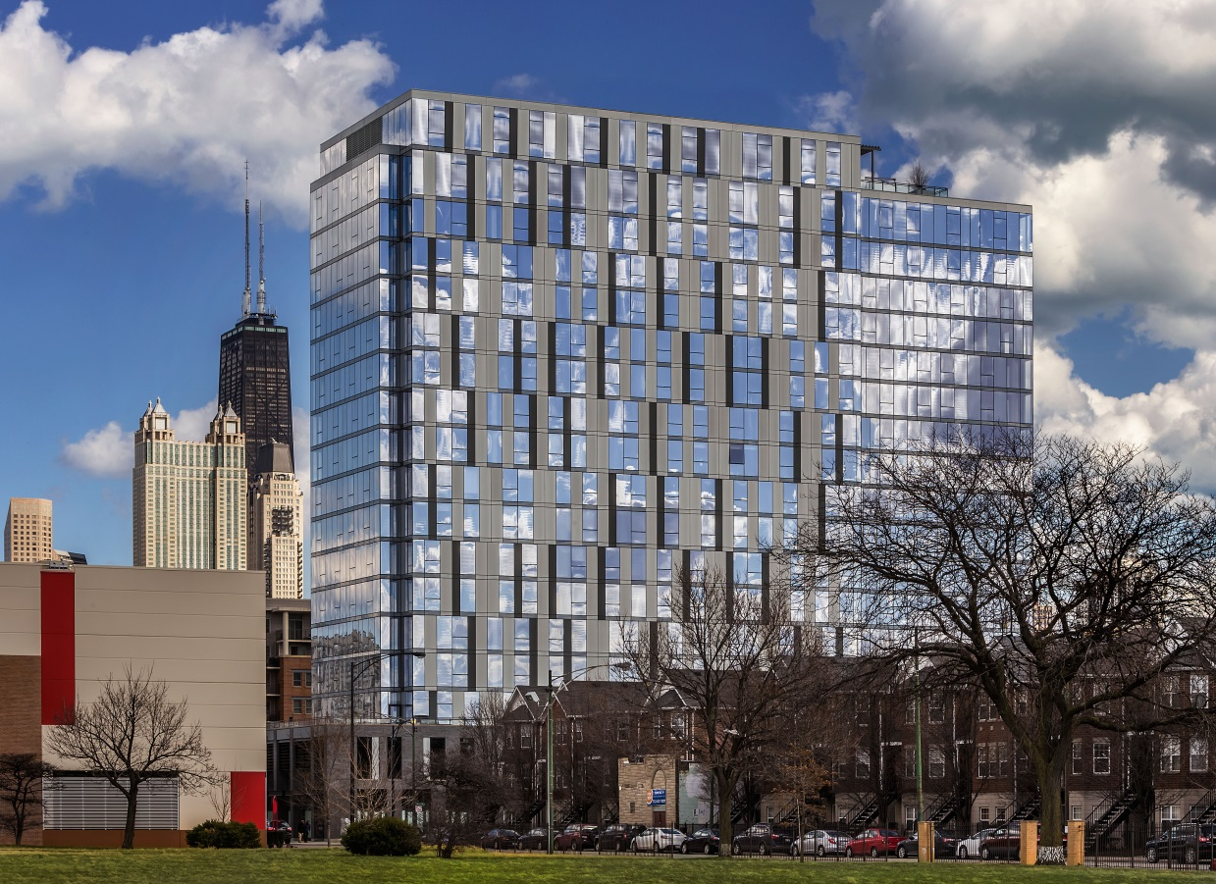
New Construction: What We Do
Providing expert technical assistance
Offer financial incentives for implementation of electric and gas energy conservation measures that exceed current Illinois Energy Conservation Code requirements
Delivering high-quality education and training
Xavier Apartments, Photo by Mark Ballogg
Coordinated program between ComEd, Nicor Gas, Peoples Gas and North Shore Gas
Notes:
NC offers incentives as opposed to rebates.
Projects include new construction, additions, and major renovations
Our primary focus it to support the design team and building owner with high quality technical assistance throughout the project in the form of energy modeling or whole-building energy simulations early in the design process.
The team has access to technical experts at no cost to identify ways to save energy and lower operating expenses through the identification of energy efficiency measures such as lighting and HVAC equipment.

Slide 6
Public Sector Under FEJA
Under the Future Energy Jobs Act (FEJA), the utilities are charged with taking on the delivery of energy efficiency offerings for these types of public sector facilities:
Units of local government (park districts, libraries, etc.)
Municipal corporations
School districts
Community college districts
Public housing*
Other public sector facilities may also qualify though different incentive structures will apply.
* Public housing new construction or major renovations may be eligible for higher incentives through the affordable housing new construction offering. For more information, view our on-demand webinar.
Notes:
- DCEO Illinois Energy Now is no longer active. All incentives for public sector are now through the utilities
Certain large energy users may be excluded from incentive programs
Make sure to explain "other public sector facilities," namely state and federal government, and public universities.
Note that public housing new construction or major renovations may be eligible for higher incentives through the affordable housing new construction offering. For more information we are providing links in the pdf we’ll share after today’s presentation to both the offering application and guidelines and an on-demand webinar that gives an overview of the offering.

Slide 7
ComEd Energy Efficiency Program New Construction
INTRODUCTION
OFFERING BASICS
TECHNICAL ASSISTANCE
CASE STUDIES
ELIGIBILITY
WRAP UP
Xavier Apartments, Photo by Mark Ballogg

Slide 8
New Construction Timeline
1
2
3
4
Confirm eligibility requirements are met
Submit application and design documentation
Engage with program team to determine optimal efficient design measures
Complete measure incentive reservation, which indicates agreement to install measures
Complete construction and schedule verification
Complete the measure installation confirmation
Photo courtesy of Roosevelt University
Photo courtesy of Roosevelt University
5
Receive incentive!
Notes:
This is an overview of what is looks like to participate in the NC program
The first thing to do is confirm that your project is eligible, the easiest way to do that is to contact myself or anyone else with the program to start discussing your project. Once that occurs you can submit and application to the program.
The most important part of the process is engaging with our team during the design phase. This is when our energy engineer will be working with the owner and design team to offer energy recommendations, they will be completing energy models for the project and incentives information.
When design is complete, the funds are reserved with the utilities and you go through your normal construction process.
At the end of construction is when we verify the energy measures and then payment is sent out as a one time check.

Slide 9
Commercial and Industrial Incentive Rates
* Incentive rates listed are for eligible commercial and industrial buildings.
* Must exceed current Illinois energy conservation code to receive incentives.
$0.14/kWh $0.70/therm
Accelerate Performance
$0.10/kWh
$0.50/therm
Comprehensive Assistance
$0.07/kWh
$0.35/therm
INCENTIVE $ / kWh, $ / therm
Expedited Assistance
Too late for new construction incentives
$0.00
Before design team selection
Before
50% design completion
Six weeks to design completion
Equipment purchased
PROJECT DELIVERY
Notes:
This slide emphasizes the importance of applying as early as possible in the design process
Higher volume of kWh is earned for more measures implemented
Greater $/kWh is earned for earlier engagement
Design incentive may be applied to any track if requirements are met
$0.50/therm up to $50,000 per project for all tracks
Incentive rate above 5 million kWh per project is awarded at a reduced rate

Slide 10
Qualified Public Sector Incentives Rates
The following types of buildings are qualified for an increased incentive rate:
Units of local government (park districts, libraries, etc.)
Municipal corporations
Public school districts
Community college districts
Public housing authorities*
* Public housing new construction or major renovations may be eligible for higher incentives through the affordable housing new construction offering. For more information, view our on-demand webinar.
Notes:
Reminder that public housing new construction or major renovations may be eligible for higher incentives through the affordable housing new construction offering.

Slide 11
Qualified Public Sector Incentive Rates
* Incentive rates listed are for qualified public sector building types only.
* Must exceed current Illinois energy conservation code to receive incentives.
$0.20/kWh $1.00/therm
Accelerate Performance
$0.14/kWh
$0.70/therm
Comprehensive Assistance
$0.10/kWh
$0.50/therm
INCENTIVE $ / kWh, $ / therm
Expedited Assistance
Too late for new construction Incentives
$0.00
Before design team selection
Before
50% design completion
Six weeks to design completion
Equipment purchased
PROJECT DELIVERY
Notes:
This slide emphasizes the importance of applying as early as possible in the design process
Higher volume of kWh is earned for more measures implemented
Greater $/kWh is earned for earlier engagement
Design incentive may be applied to any track if requirements are met
$0.50/therm up to $50,000 per project for all tracks
Incentive rate above 5 million kWh per project is awarded at a reduced rate

Slide 12
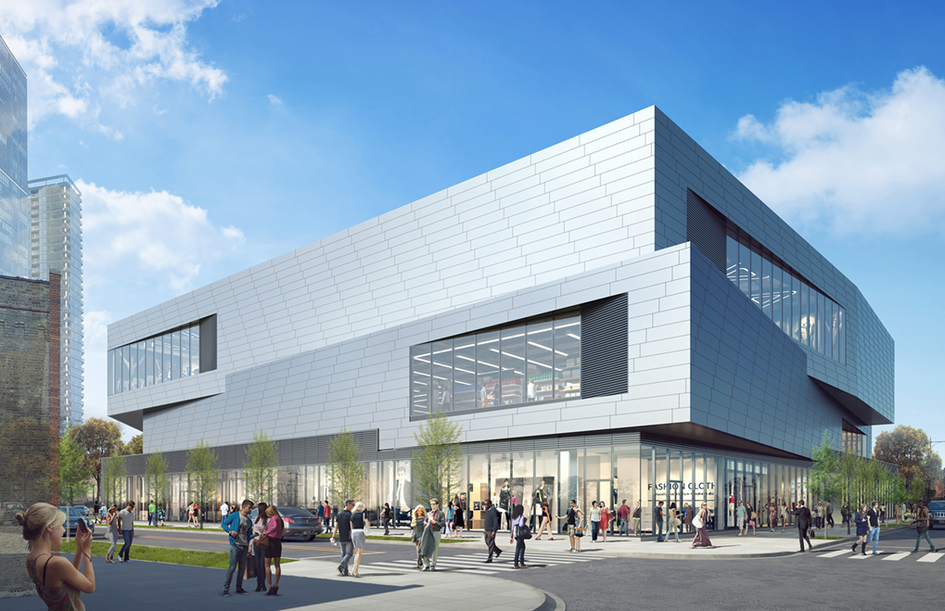
Accelerate Performance for Eligible Commercial and Industrial Sector
Performance-Based Procurement
For building owners and developers:
Provide project technical support in programming phase
Assist with requests for proposal (RFPs) and contract language to establish energy performance requirements
Identify appropriate energy use intensity (EUI) targets
Increase energy efficiency incentives
Image Courtesy of Structured Development and CallisonRTKL
Up to $0.14/kWh and $0.70/therm for projects engaging before hiring design team and implementing energy requirements
Notes:
Program empowers owners and developers to achieve desired energy performance goals within project budget
Helps building owners/developers prioritize energy goals and specify appropriate energy performance requirements from beginning
Set agreeable goal between client and future design team; Integrated into existing RFP and contact documents
Gives flexibility in design for responses to RFPs, but sets goal for energy use – no requirements on equipment or materials used, but understandable goal for efficiency
- Benefit: Training and resources by the program team to follow this model/process for future projects to ensure energy efficiency in NC/major renovations

Slide 13
Comprehensive Assistance for Eligible Commercial and Industrial Sector
Analysis Tailored to Your Project
Up to $0.10/kWh and $0.50/therm for projects engaging between concept planning and 50 percent design completion
Identify optimal energy efficiency strategies
Detailed whole-building energy analysis
Notes:
In this phase, you’re designing the more technical elements of the building and creating floor plans. We evaluate those drawings through energy modeling to find the optimal performance for your building and create energy efficiency design recommendations from this modeling.
Reach beyond IL Energy Conservation Code requirements and exceed them for optimal building performance
Conduct whole building analysis that looks at target EUIs and overall performance; provide recommendations and feedback to help reduce overall energy use and improve design for energy efficiency
Deliver results in the form of energy model report
Discuss upfront costs and long term saving opportunities
Provide iterative modeling as well – find best solutions for building and budget
Project MUST address beyond-code upgrades in 2 out for 4 building systems to qualify for NC program in all phases

Slide 14
Expedited Assistance for Eligible Commercial and Industrial Sector
Further Along but Seeking Technical Assistance?
We Can Still Help!
Up to $0.07/kWh and $0.35/therm for projects engaging after 50 percent design completion with at least six weeks to design completion
Suggest building energy efficiency opportunities
Expedited building energy analysis
Notes:
Enter in program early, but if later in design, can still participate in the New Construction program to optimize building performance.
Modeling is a more expedited process, allows for quicker turnaround for communication with design team
Not big recommendations, but try to still provide easy improvement recommendations to address energy efficiency and use
6 weeks to design completion is bare minimum and we recommend acting earlier
Aren’t sure where to fit? Let’s chat! Call, email, discuss opportunities EARLY!!

Slide 15
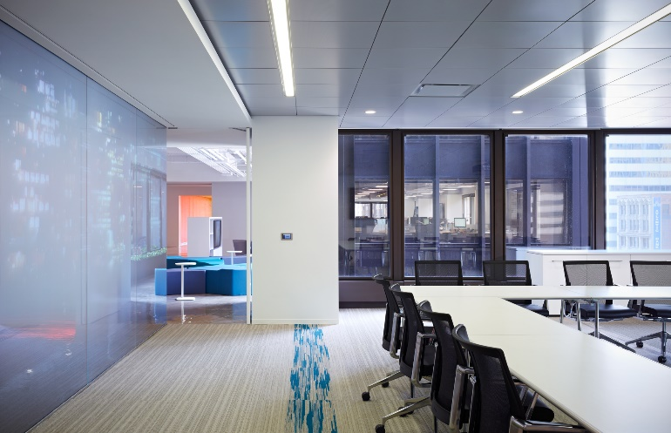
Benefits for Design Firms
Access to nationally recognized energy efficiency expertise
Community recognition for sustainable design
Potential incentive for your clients
Potential incentive for the lead design firm:
Photo courtesy Cannon Design and Christopher Barrett Photography
Up to 10 percent of owner’s incentive (additional) for firms fully engaged with the technical assistance team
Notes:
Design team bonus – Active engagement throughout process (communication, documentation requested, engage in tech assist team convos) – additional incentive, not taken away from the owner
The individuals with which we partner are primarily on the design team, which include architects, engineers, lighting designers, and consultants and contractors.
Many of our projects come directly from building owners, developers, and facility managers.
An additional benefit that you can offer your client
You can submit the application directly to us on the owner’s behalf – requires customer’s signature

Slide 16
ComEd Energy Efficiency Program New Construction
INTRODUCTION
OFFERING BASICS
TECHNICAL ASSISTANCE
CASE STUDIES
ELIGIBILITY
WRAP UP
Xavier Apartments, Photo by Mark Ballogg

Slide 17
Technical Assistance Overview
Our Team Will…
Meet with building owners and design teams to set goals and strategies for energy efficiency
Conduct design review and provide feedback on energy efficiency solutions
Evaluate design options and suggest areas for optimizing energy efficiency
Conduct holistic energy modeling (eQUEST, Trane TRACE, OpenStudio, NEO)
Determine best energy value among different design alternatives
Notes:
*Hand out some modeling summary reports at this time
This is when our energy engineer engages with your project
We do a review of the design, no matter where it is in the process
They will evaluate design options for you and help determine where to optimize energy efficiency
They will do a whole-building energy analysis and can use a number of different software in order to best assist you

Slide 18
Energy Analysis - Process
DEFINE
REPORT
Shape and geometry
Weather
MODEL
Electricity
usage
Lighting
Schedule
Gas usage
Human loads
Plug loads
Incentives/ savings
Equipment
UPDATE
Systems (heating and cooling)
Energy
reduction
Notes:
So what goes in to an energy model?
Looking at things on the left for the model and then reporting on the right column

Slide 19
Modeling Results Example
Notes:
This is what you can expect to see in the summary report from the engineer
You can see that the incentives come from the energy saved beyond code baseline. The energy engineer creates a baseline model, which is the project built to code baseline, and then compares the more efficient model to that. And the delta between the two is where the financial incentives come from.

Slide 20
Incentive Calculation Example
Based on modeled annual energy usage (one year)
Code building 1,076,168 kWh 95,132 therms
Your building 785,090 kWh 72,747 therms
Energy savings 291,078 kWh and 22,385 therms
–
(291,078 kWh saved x incentive rate)
(22,385 therms saved x incentive rate)
$ Owner incentive
+
$ Owner incentive x 10% = $ Design team incentive
Notes:
Here is how we are calculating the savings based on modeled annual energy usage
This is all modeled data, we are not verifying it at the end of construction – if your building doesn’t deliver that, there isn’t a penalty

Slide 21
Annual Energy Cost Savings by Measure
Energy Efficiency Measure | Incentive | Annual Energy Cost Savings | Annual Electric Energy Savings | Annual Gas Energy Savings
Window Assembly U-value | $15,750 | $15,754 | 157,624 kWh | 0 therms
Window Solar Heat Gain | $17,767 | $17,906 | 174,209 kWh | 693 therms
Interior Lighting Power | $16,912 | $16,619 | 176,412 kWh | 0 therms
Condensing Boilers | $1,095 | $972 | 0 kWh | 2,189 therms
Notes:
And here is an example of the types of recommendations you will see on the summary report and the information it provides

Slide 22
ComEd Energy Efficiency Program New Construction
INTRODUCTION
OFFERING BASICS
TECHNICAL ASSISTANCE
CASE STUDIES
ELIGIBILITY
WRAP UP
Xavier Apartments, Photo by Mark Ballogg

Slide 23
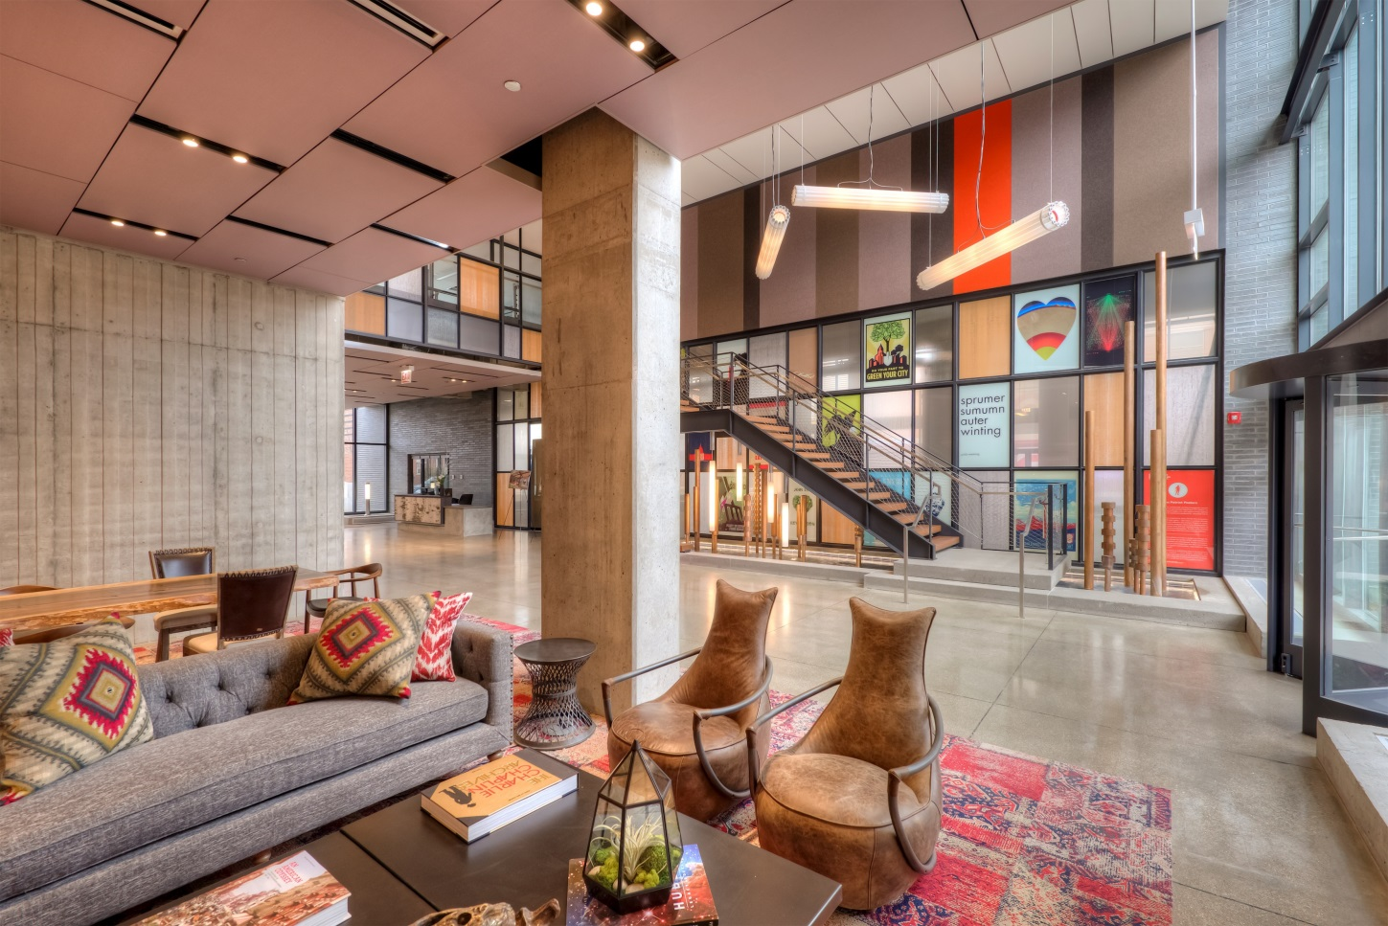
Xavier Apartments
PROJECT PROFILE
Customer Gerding Edlen, Chicago
Building Area 288,850 square feet
Owner Incentive $70,099
Architect GREC Architects
Engineer WMA Consulting Engineers
Design Lead Incentive $7,010
Estimated Annual Energy Savings 886,912 kWh/32,391 therms
Estimated Annual Cost Savings $108,274
Xavier Apartments, Photo by Steve Somen
Additional wall and roof insulation
High-performance curtainwall
Efficient interior and exterior lighting and daylighting strategies
High-efficiency HVAC equipment
Measures implemented (partial list)

Slide 24
ComEd Energy Efficiency Program New Construction
INTRODUCTION
OFFERING BASICS
TECHNICAL ASSISTANCE
CASE STUDIES
ELIGIBILITY
WRAP UP
Xavier Apartments, Photo by Mark Ballogg

Slide 25
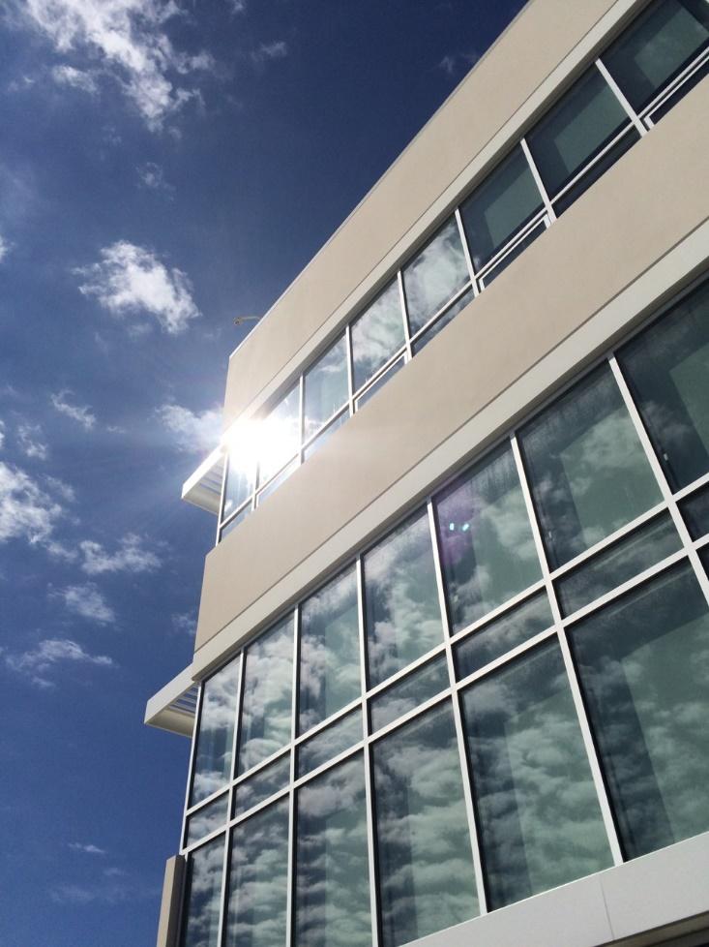
New Construction Eligibility
We Can Support Building Design Projects That Are:
In ComEd service territory
New construction or major renovation
Minimum 5,000 square feet
Exceed current Illinois Energy Conservation Code requirements
Early in design
And…
Photo courtesy of Sunstar Americas, Inc.
Notes:
Program eligibility requirements:
The baseline is code, and incentives are based on how far the project’s design exceeds code.
Taking the prescriptive approach through ASHRAE 90.1-2013, we have found to be more consistent with the goals of the design teams.
Commercial, industrial, or multi-family
Minimum 5,000 sq.ft. minimum area requirement
2 or more systems must be included in project (lighting, HVAC, envelope, refrigeration)
Design incentive – 10% of the overall measure incentive awarded to the design team lead that worked with our team through the duration of the project. The design incentive is awarded in addition to measure incentive that the owner receives.
Early in design – 50% DD or earlier, ideally in the planning or schematic design phase

Slide 26
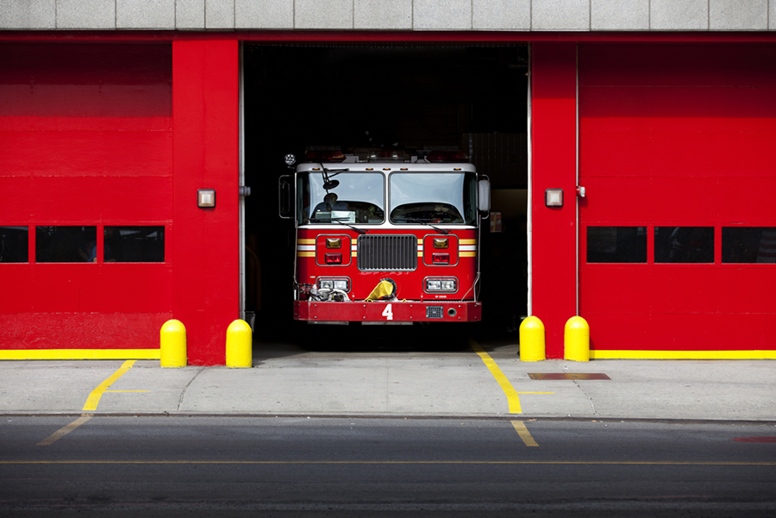
New Construction Eligibility
We Can Support Building Design Projects That:
Implement significant beyond-code energy conservation measures (ECMs) for at least two of these primary building systems:
Envelope
Primary HVAC equipment
Lighting
Qualified refrigeration*
Did we mention early in design?
Photo courtesy of Sunstar
*Typically applies to refrigerated warehouses and grocery stores
Notes:
Program eligibility requirements:
The baseline is code, and incentives are based on how far the project’s design exceeds code, which is IECC 2015.
Taking the prescriptive approach through ASHRAE 90.1-2013, we have found to be more consistent with the goals of the design teams.
Commercial, industrial, or multi-family
Minimum 5,000 sq.ft. minimum area requirement
2 or more systems must be included in project (lighting, HVAC, envelope, refrigeration)
Design incentive – 10% of the overall measure incentive awarded to the design team lead that worked with our team through the duration of the project. The design incentive is awarded in addition to measure incentive that the owner receives.
Early in design – 50% DD or earlier, ideally in the planning or schematic design phase

Slide 27
Participation Timeline: Accelerate Performance
Notes:
Application is submitted during project planning, design team has not been hired
TA team is helping to set language in RFP, help identify qualified professionals to help you meet your goals

Slide 28
Participation Timeline: Comprehensive Assistance
Notes:
For this track you can apply anywhere between concept design and early in design development
This still gives plenty of time to engage with the TA team

Slide 29
Participation Timeline: Expedited Assistance
Notes:
This track was developed in the last couple years for projects that are on fast track construction processes where there just isn’t a lot of time in design
Or you learned about the program late and still want to apply
We use a more expedited modeling process

Slide 30
ComEd Energy Efficiency Program New Construction
INTRODUCTION
OFFERING BASICS
TECHNICAL ASSISTANCE
CASE STUDIES
ELIGIBILITY
WRAP UP
Xavier Apartments, Photo by Mark Ballogg

Slide 31
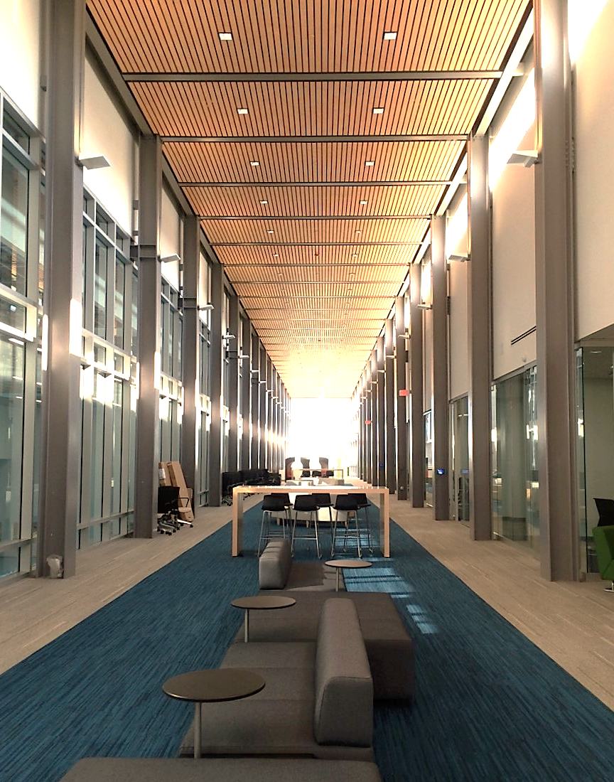
Key Items to Remember
Bring your projects to our team early in design
Stay engaged with our technical team throughout the design process
Implement significant beyond-code energy conservation measures (ECMs) for at least two primary building systems
Photo courtesy of Sunstar Americas, Inc.

Slide 32
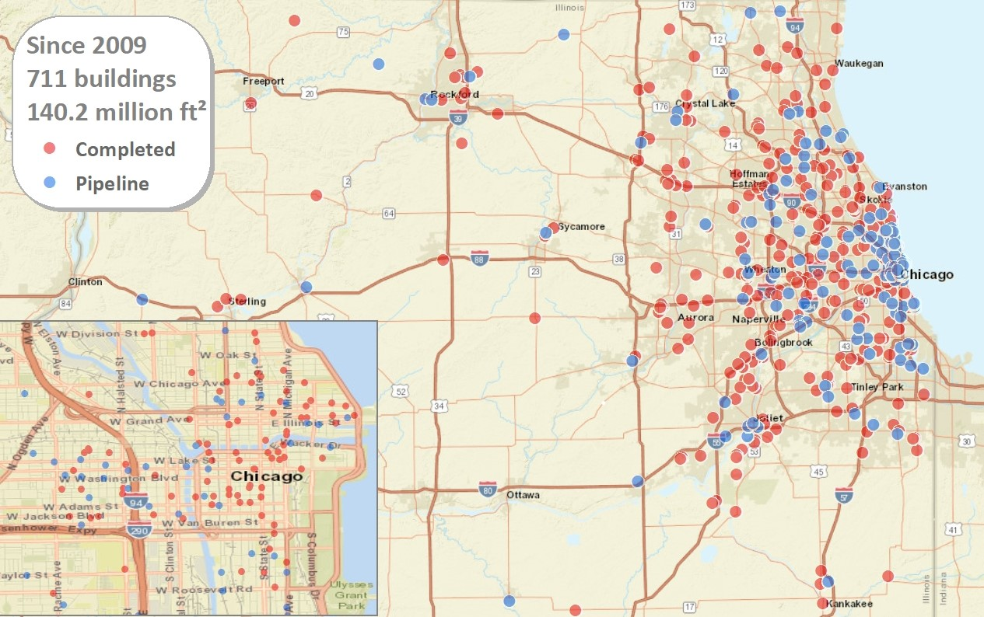
Experienced Team
Notes:
Greatest activity seen in downtown Chicago –the hottest part of the construction market (lower left corner). But we’re also seeing a growing number of projects across Northern IL, with much construction activity increasing in the suburbs just west of metropolitan Chicago.
Primary markets we serve include healthcare, higher-ed, industrial/warehouse, retail/service, multi-family, hospitality, office.
Capturing 60% of the eligible square footage of the new construction and major renovation market in ComEd territory cited from ConstructConnect, the 2016 forecast for new construction starts. Emphasize that this is square footage, not number of buildings or projects.

Slide 33
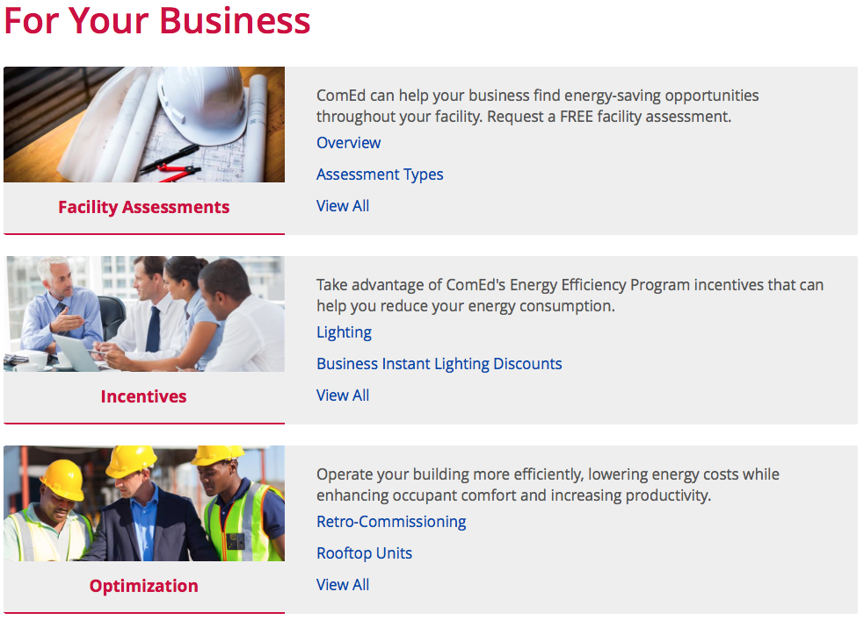
Thank you! Program Information
ComEd Incentives ComEd.com/BizIncentives
ComEd New Construction ComEd.com/NewConstruction
ComEd Public Sector ComEd.com/PublicSectorEE
Outreach Support Contact:
Hanh Pham Project Manager 773-842-7902 hpham@willdan.com
Notes:
If you’re not sure if NC is the right fit, still give us a call and we’ll point you in the right direction.

